Slide 1
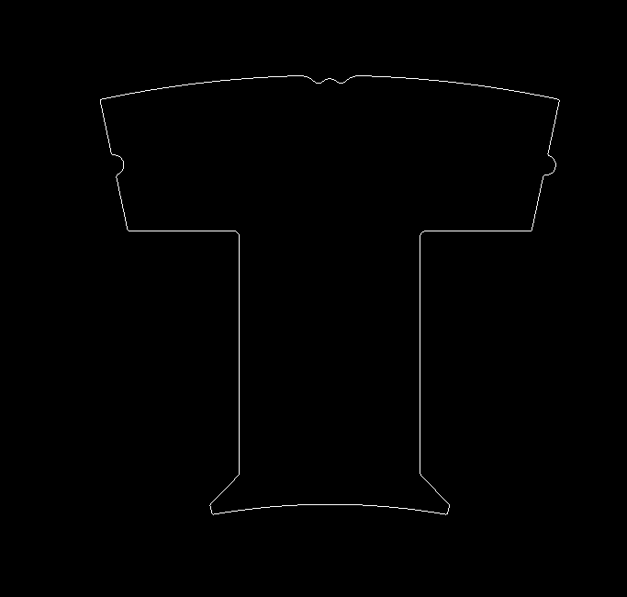
A
R 100
.05 A

