Slide 1
Element Calculation

Slide 2
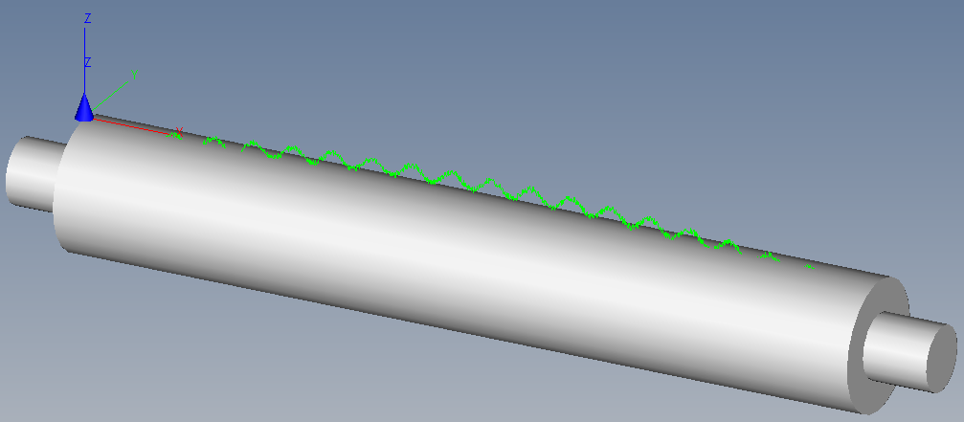
Content
Element Calulation (Standard Geometry)
Characteristic values
Form, Minimum, Maximum, Range
Histogram, Normaldistribution, Sigma
Handle outliers

Slide 3
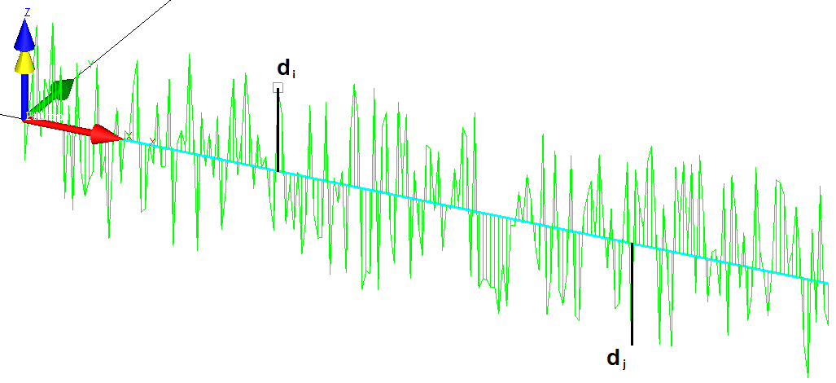
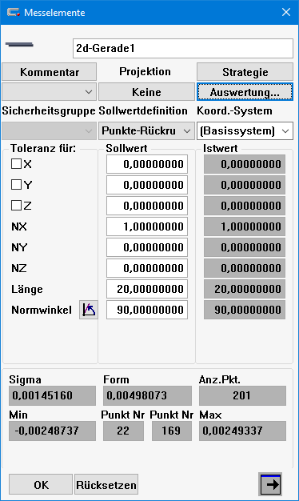
Principle
Deviation
Iteratively calculated element
n | Dev [mm] | Dev [µm]
1 | -0.000995 | -0.99541
2 | 0.000119 | 0.11877
3 | 0.001153 | 1.15264
4 | 0.002342 | 2.34156
5 | -0.000338 | -0.33789
6 | 0.001089 | 1.08858
7 | 0.000714 | 0.71443
8 | 0.002482 | 2.48172
9 | 0.000210 | 0.20982
10 | 0.001448 | 1.44751
11 | -0.001732 | -1.73169
12 | 0.000564 | 0.56423
13 | -0.001960 | -1.96010
14 | 0.001625 | 1.62516
15 | -0.000966 | -0.96606
16 | -0.001579 | -1.57888
17 | -0.001173 | -1.17278
18 | -0.000938 | -0.93820
19 | 0.001691 | 1.69060
20 | -0.001060 | -1.05971
… | … | …
Gauss – Condition
Sigma s =
Minimum d_{min}
Maximum d_{max}
Range R = d_{max} - d_{min}
= Minimum
f = Degree of freedom
Identical number of
minimum points
e.G
Line = 2
Circle= 3
…

Slide 4
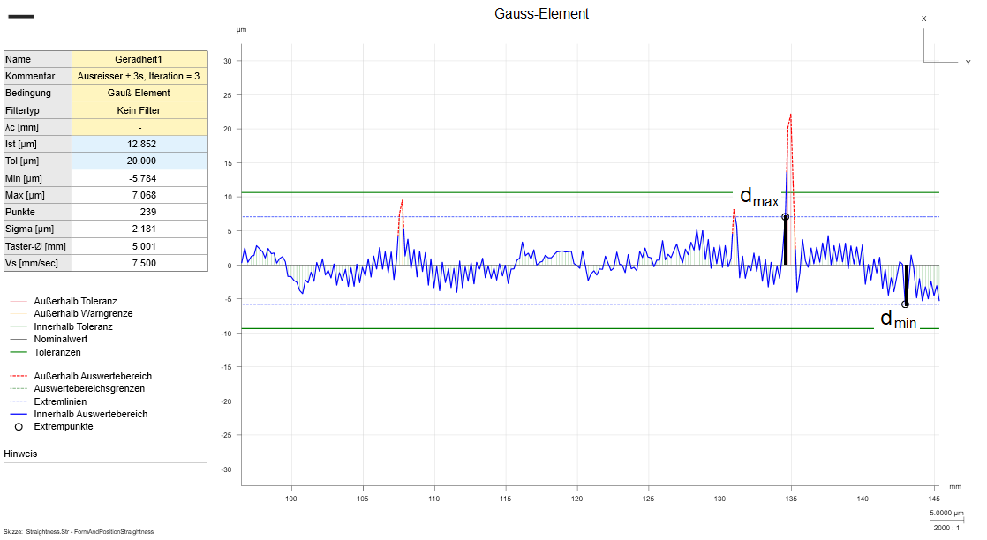
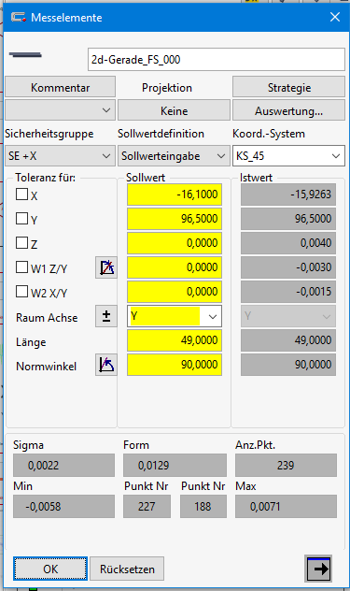
Gaussian (GG)
Gaussian-Condition
Iteratively calculated element
= Minimum
Gaussian-Condition
Calculate the element in such a way that the sum of the squared distances is minimal.

Slide 5
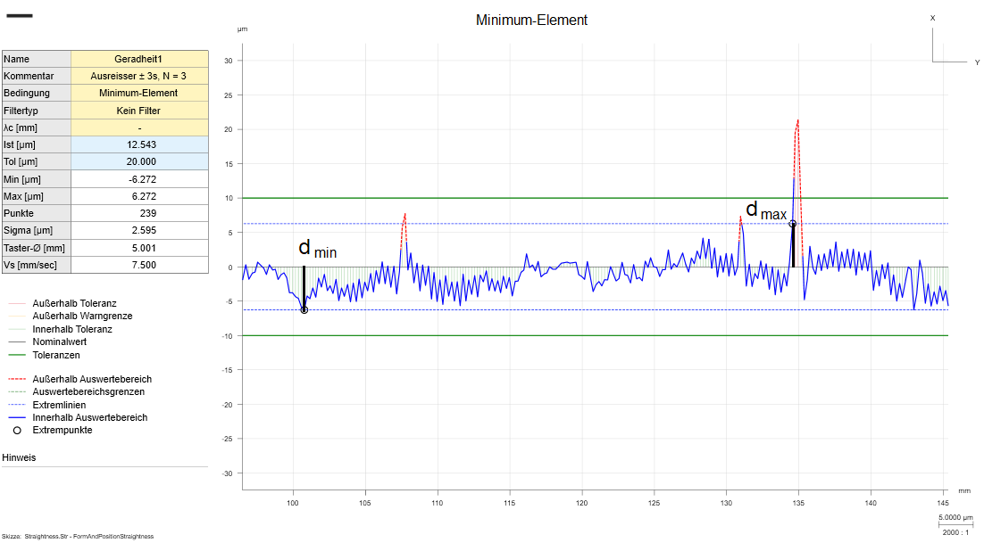
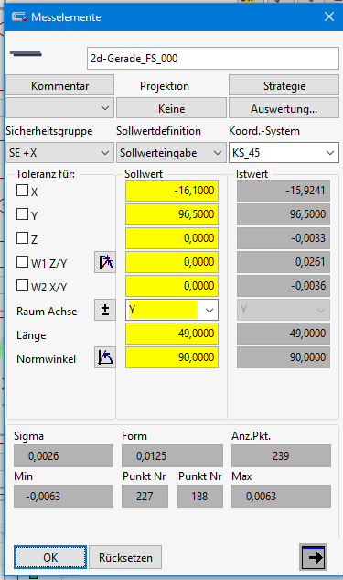
Minimum (GC)
Minimum-Condition
(Tschebycheff)
Iteratively calculated element
$\left|dmax\right|$ = $|dmin|$ = Min
Minimum-Condition
Calculate the element in such a way that the amount of d_{min} and d_{max} both equal and minimal.

Slide 6
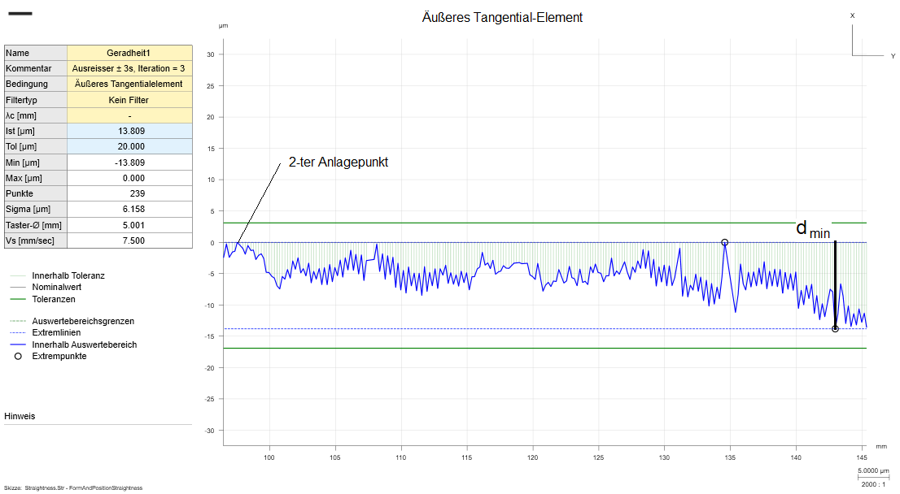
Line & Plane Circular Outer Tangent (GX) MCC
Condition
Iteratively calculated element
2nd contact
$d$_{max} = 0
MCC-Condition
Calculate the element in such a way that the diameter is minimal and all no point is outside.
Outer Tangent-Condition
Calculate the element in such a way that no point is outside.

Slide 7
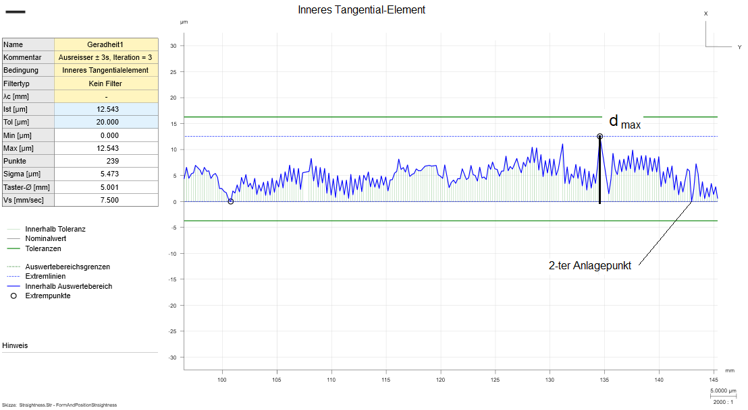
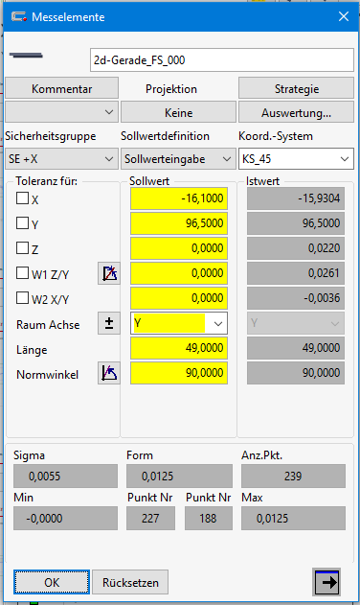
Line & Plane Circular Inner Tangent (GN) MIC
Condition
Iteratively calculated element
$d$_{min} = 0
2nd contact
MIC-Condition
Calculate the element in such a way that the diameter is maximal and all no point is inside.
Inner Tangent-Condition
Calculate the element in such a way that no point is inside.

Slide 8
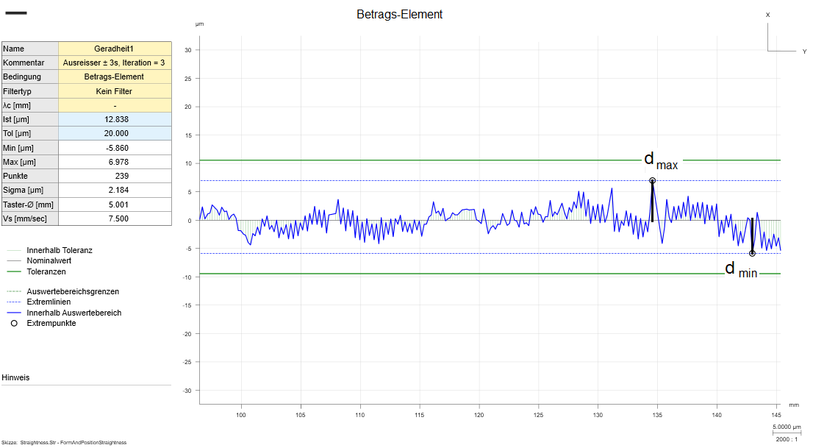
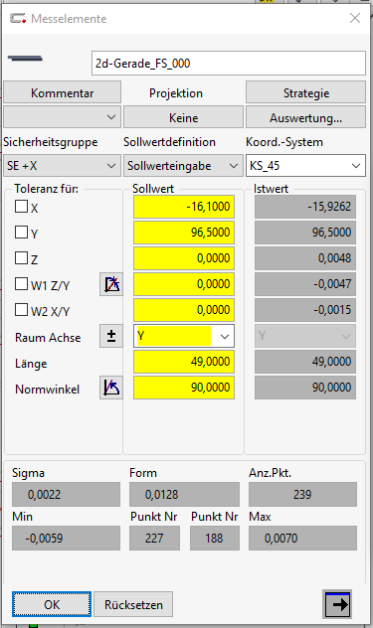
L1 Element
Condition
Iteratively calculated element
$$\sum_{1}^{n}{\left|di\right|=Minimum}$$
L1-Condition
Calculate the element in such a way that the sum of the distances is minimal.

Slide 9
Outlier
Deviation [μm]
Histogram – Distribution
Min - Max
RawData
± 3*s
Without Outliers
± 3*s
 |  | All [mm] | [µm] |  | noOutlier [µm]
Xbar |  | 0.000080 | 0.080042 |  | 0.09220
StdDev |  | 0.001512 | 1.512192 |  | 1.447799
min |  | -0.004731 | -4.730524 |  | -0.002487
max |  | 0.004712 | 4.712243 |  | 0.002493
Range |  | 0.009443 | 9.442767
Median |  | 0.000110 | 0.110342
-3s |  | -0.004457 | -4.456532 |  | -4.251197
+3s |  | 0.004617 | 4.616617 |  | 4.435600

Slide 10
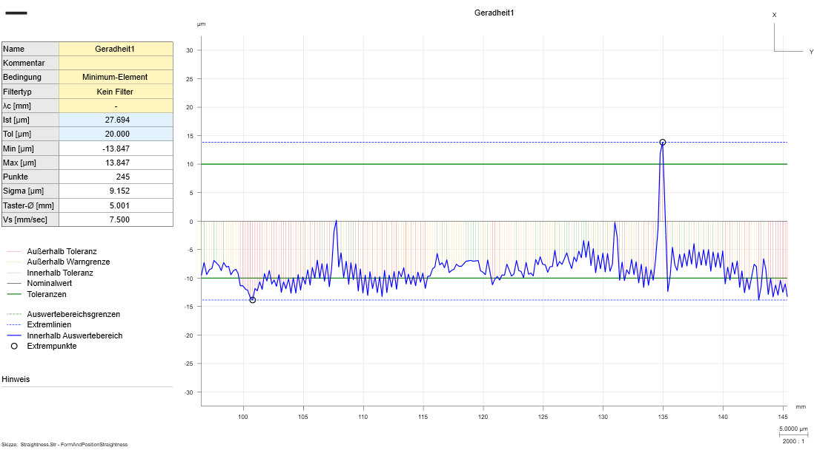
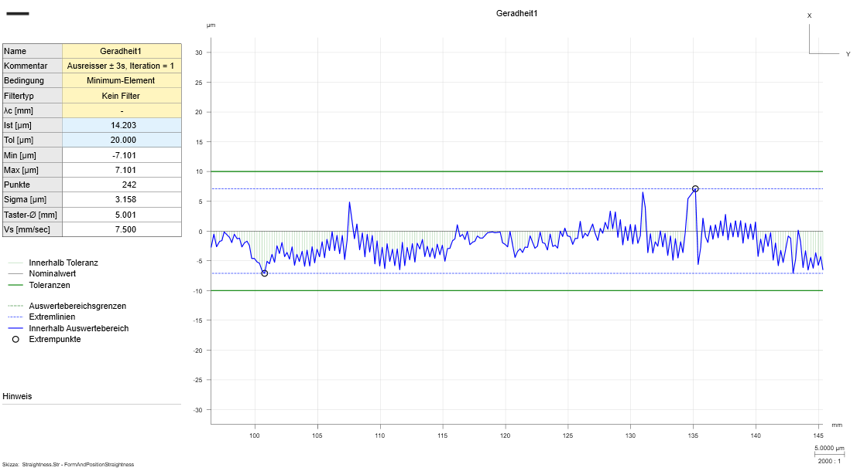
Outlier with Iterations
 | No Pt | 10 | 100 | 1000 | 10000 | 100000
 | [%]-inside | Outliers
± 1 * s | 68.268949 | 3.2 | 31.7 | 317.3 | 3173.1 | 31731.1
± 2 * s | 95.449974 | 0.5 | 4.6 | 45.5 | 455.0 | 4550.0
± 3 * s | 99.730020 | 0.0 | 0.3 | 2.7 | 27.0 | 270.0
± 4 * s | 99.993666 | 0.0 | 0.0 | 0.1 | 0.6 | 6.3
± 5 * s | 99.999943 | 0.0 | 0.0 | 0.0 | 0.0 | 0.1
 | noFilter |  | ±3s, Iteration = 1 |  | ±3s, Iteration = 2 |  | ±3s, Iteration = 3
Pt | 245 |  | 242 |  | 239 |  | 239
min [µm] | -13.847 | 233 | -7.101 | 230 | -6.272 | 227 | -6.272 | 227
max [µm] | 13.847 | 193 | 7.101 | 191 | 6.272 | 188 | 6.272 | 188
Form [µm] | 27.694 |  | 14.203 |  | 12.543 |  | 12.543
Sigma [µm] | 9.152 |  | 6.272 |  | 2.595 |  | 2.595
Extern outliers are deleted
Principel shape isn‘t modified
➔ i.e. only outliers were deleted

