Slide 1
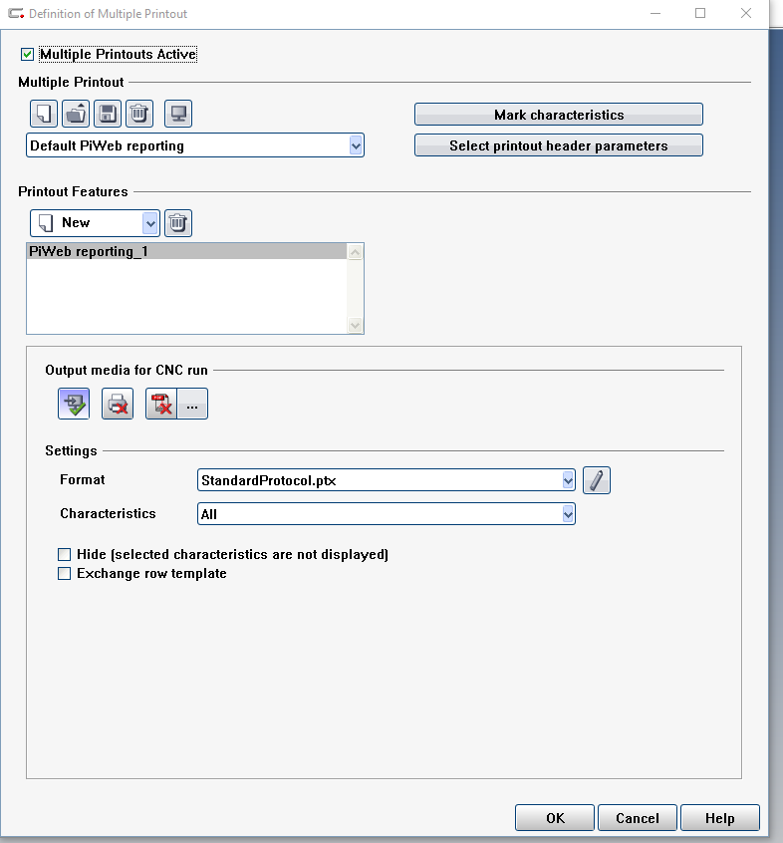
Default screen with new program in Calypso.
Manually changing the printout setting and
Header parameters is a pain in the butt.
You can save the way the CMM outputs these files
And recall them with one click.

Slide 2
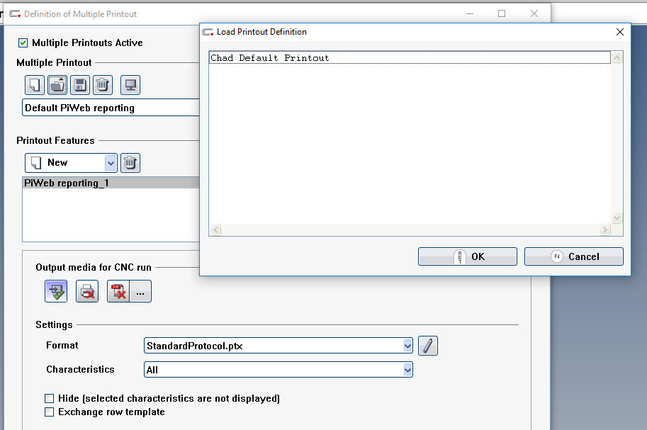
You can save the way you output
CMM results and recall them by
Clicking here. I use custom printout
As well.
Basically when I make a new program
I can output my results the same with
One click.

Slide 3
Works the same way with header data by clicking here.

