Slide 1
PiWeb for Casey
Chad Watton

Slide 2
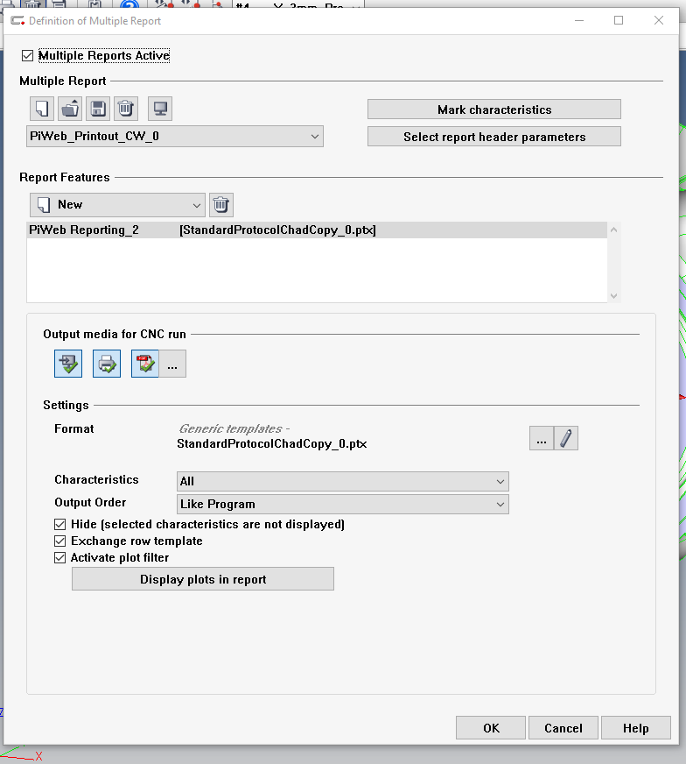
Click here to bring up report editor

Slide 3
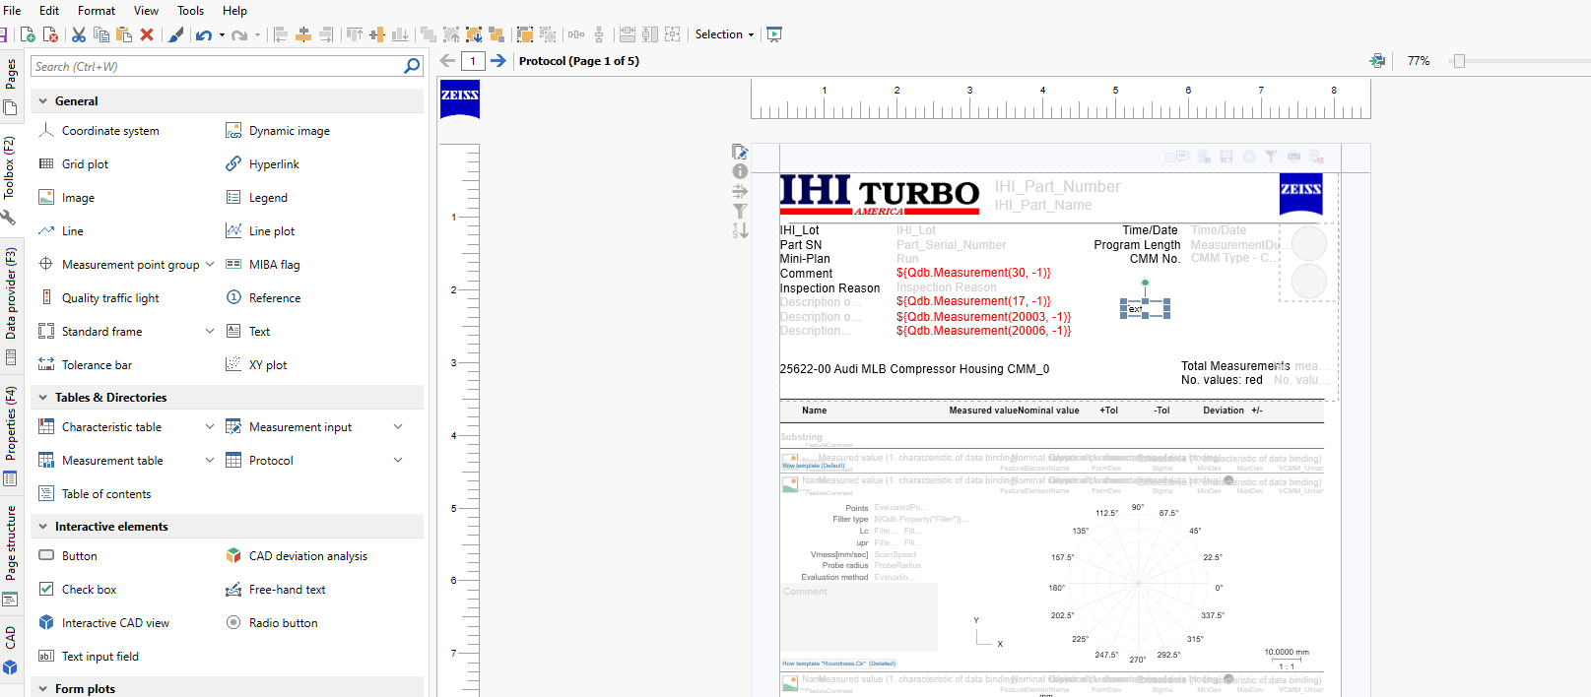
Click drag and drop a text element onto the report head

Slide 4
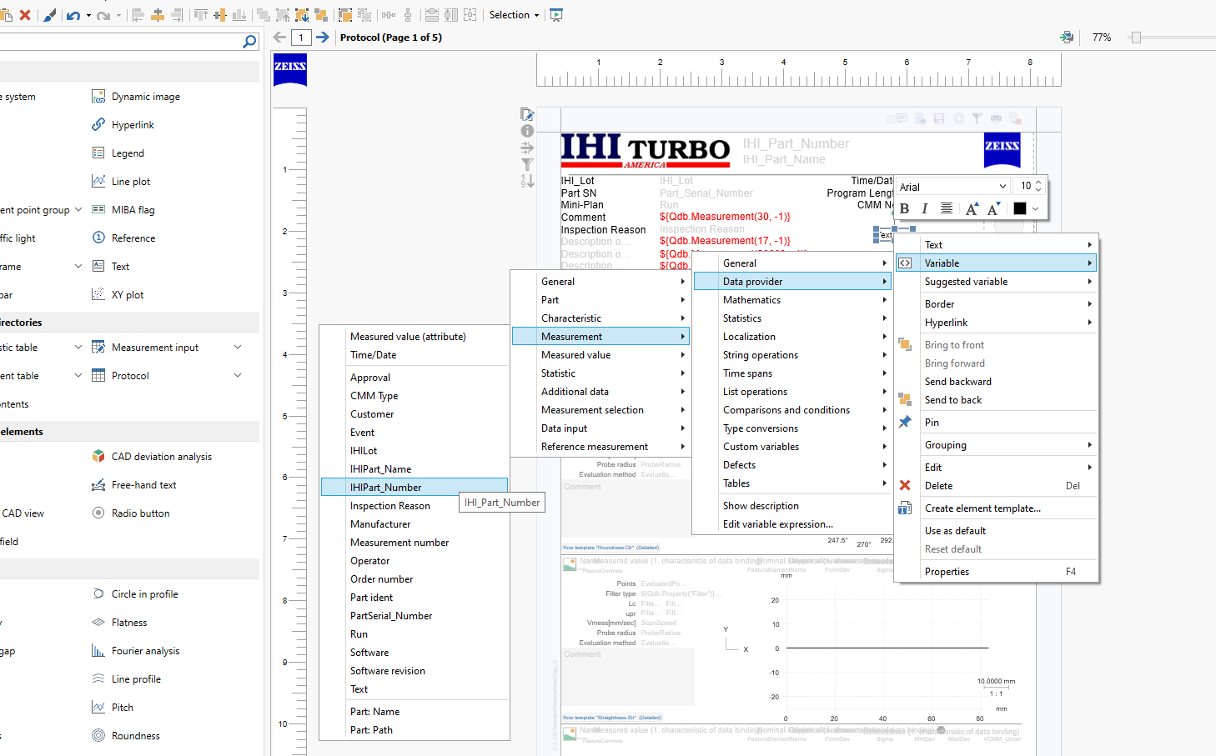
Then right click on the text element. Navigate to the variable that you want the text element to display.
One important note. This is where you have to make sure you have ran the part atleast one time to populate the PiWeb database. Other wise non of the variables you are looking for will be on this list.
It sounds confusing but you will get it once it burns you a couple times.

Slide 5
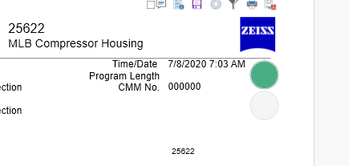
The part number is now displayed on the report.

Slide 6
Before you go to the next step, you need to know the PiWeb number for the variable you need. In the properties tab, click inside of the text box.
In this case, the part serial number variable assignment is 20002. Note this somewhere.

Slide 7
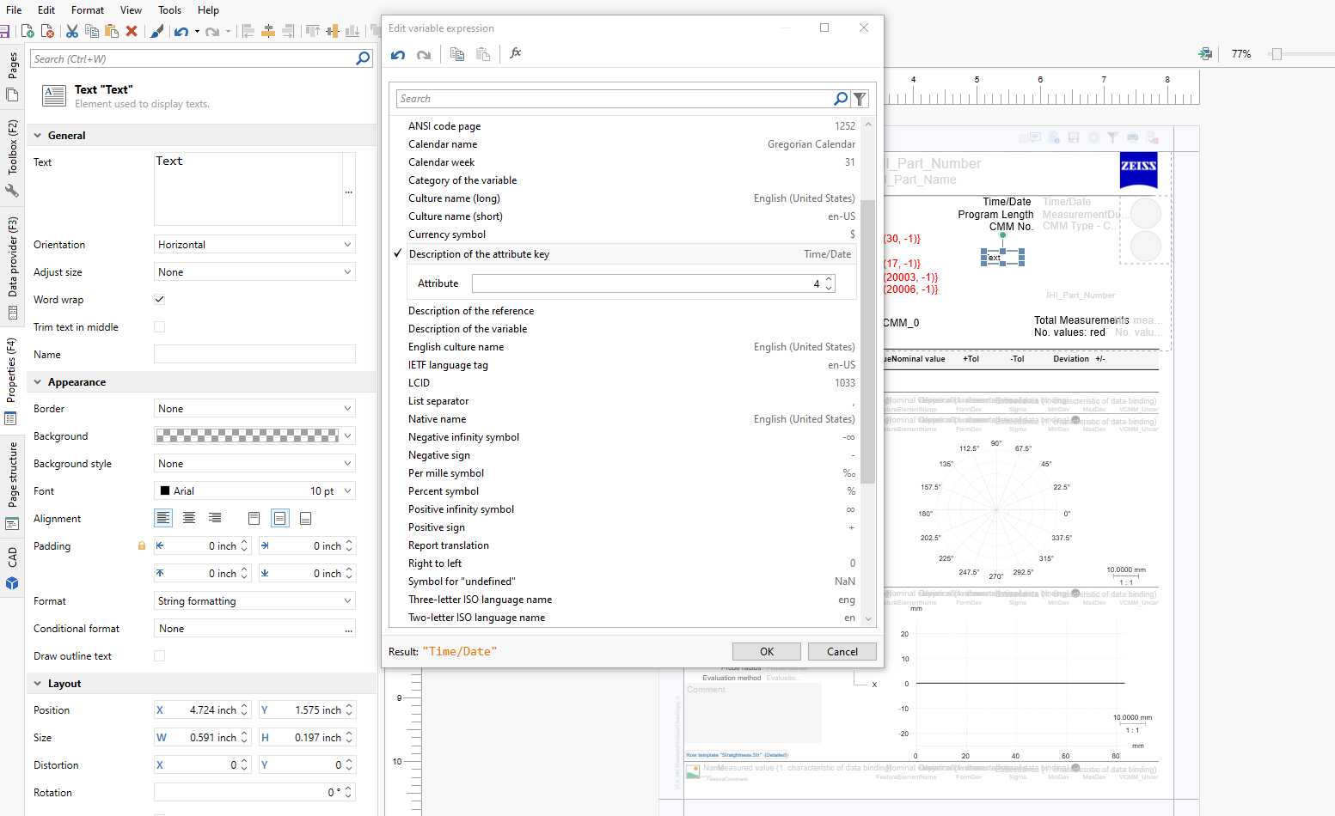
Adding a label
Click these 3 dots to bring up this menu.
Drop in another text element.
This time navigate to the properties tab
Click on the three dots.
Navigate to localization
Then description of attribute key
Type in the number you saved from before.
This will display a the text of your label.

Slide 8
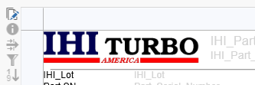
Notice how the lot number is now 99.
Design view
Report view

