Slide 1
Audi Compressor Housing
Threads vs Plugs Position Study
Chad Watton
11.19.18

Slide 2
Background

Slide 3
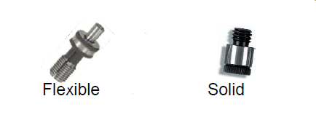
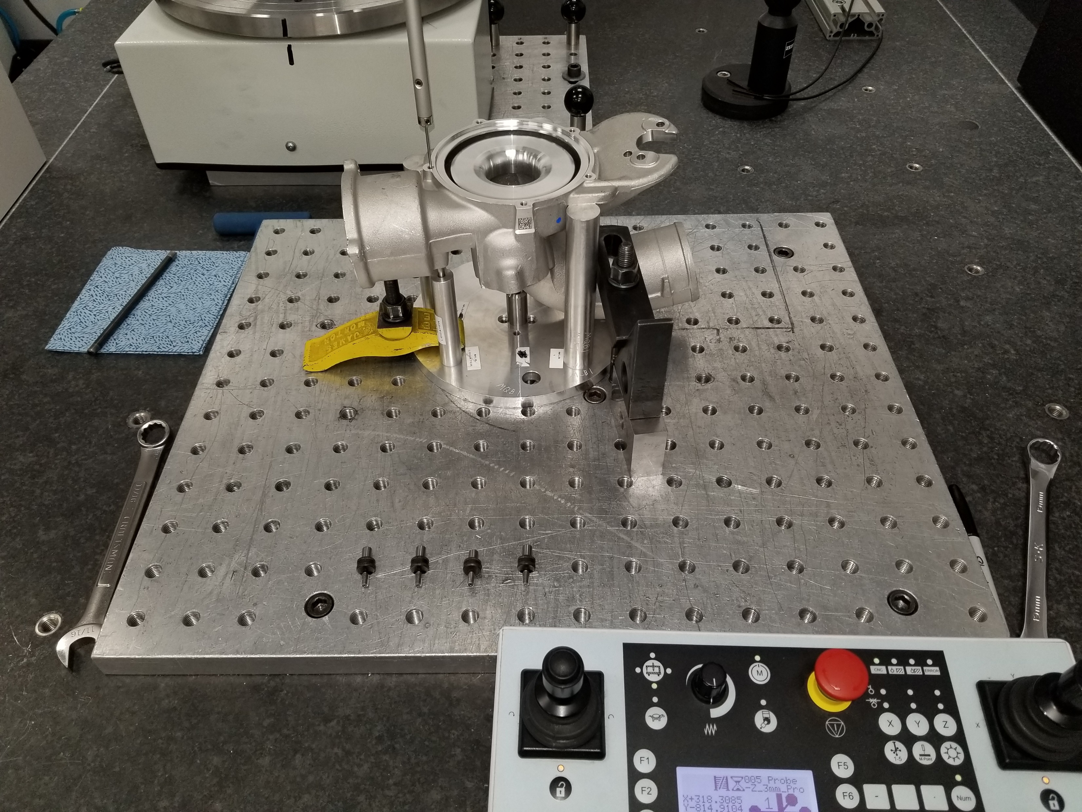
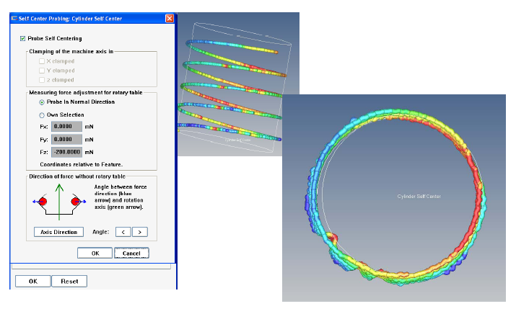
Set up
The same part was measured 10 times each for 3 different measuring strategies. Measuring directly on threads, using conventional(solid) plugs, and using flex plugs. The same part and fixture was used for each test.
The measurement strategy used to measure on the threads was a cylinder with self-center helix matched to the thread pitch. This strategy follows the ‘valley’ of the threads and makes 7 helical rotations at the thread pitch. The theory being that the point density will average out to the correct centerline.

Slide 4
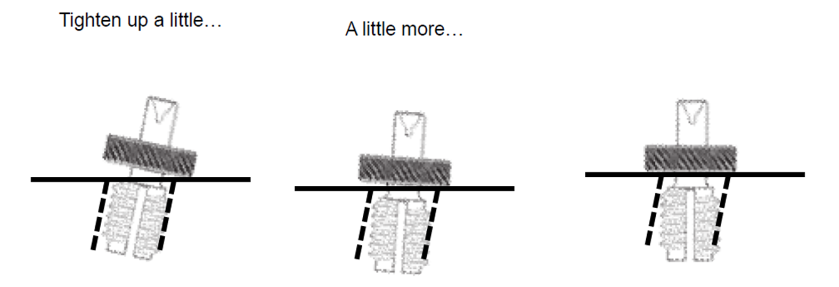
Set up Cont.
For the test with plugs, the plugs were removed and reinserted for each run. The reason for this, is because the way the plug interfaces with the part can have an impact on the measurement results.
For example,
The center point of a plug will move based on how tight the plug is tightened.
Also, the quality of the surface finish between the plug and mating surface can have an impact at well. You really see this on cast surfaces.

Slide 5
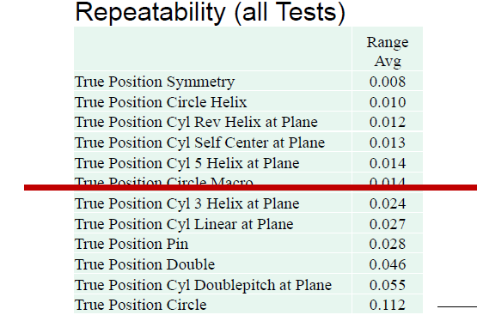
Predictions
The similar study done at Ellison Technologies predicted that the measuring directly on threads would be more repeatable than measuring on solid position plugs.
The same study states that the way the position plug interfaces with the part will have an impact on the results.

Slide 6
Solid Plugs Results

Slide 7
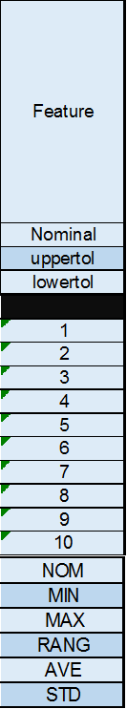
Flex Plugs Results

Slide 8
On Threads Results

Slide 9
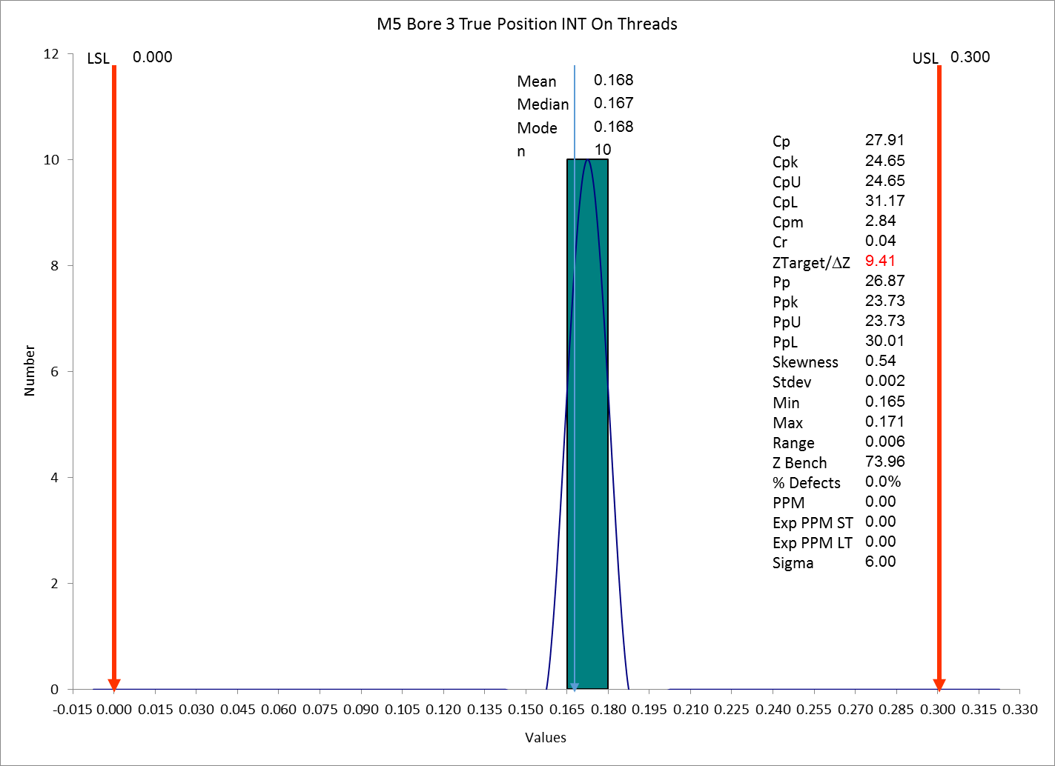
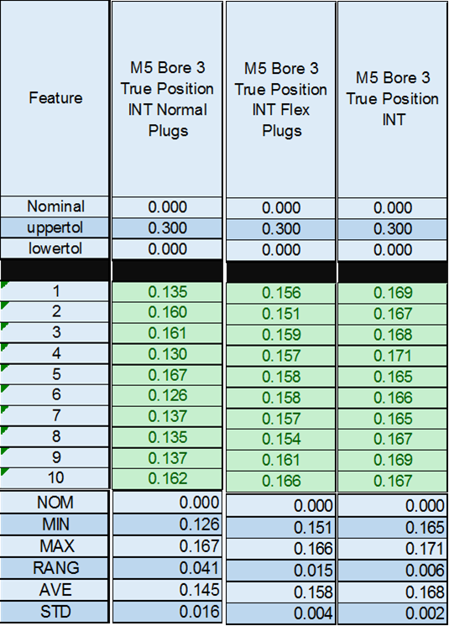
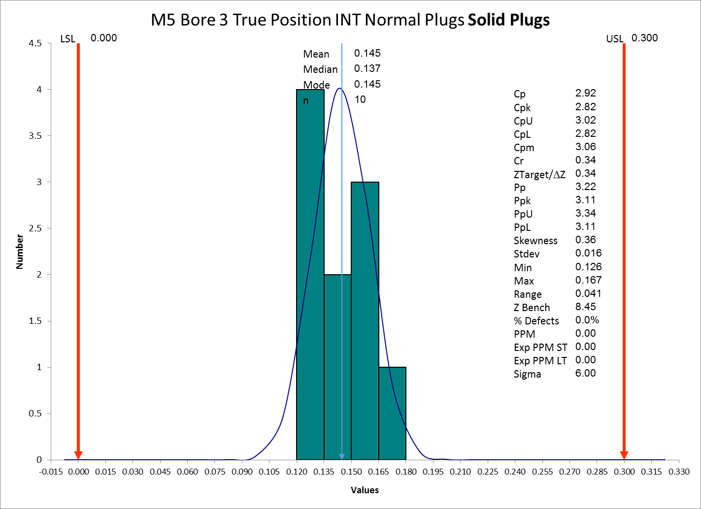
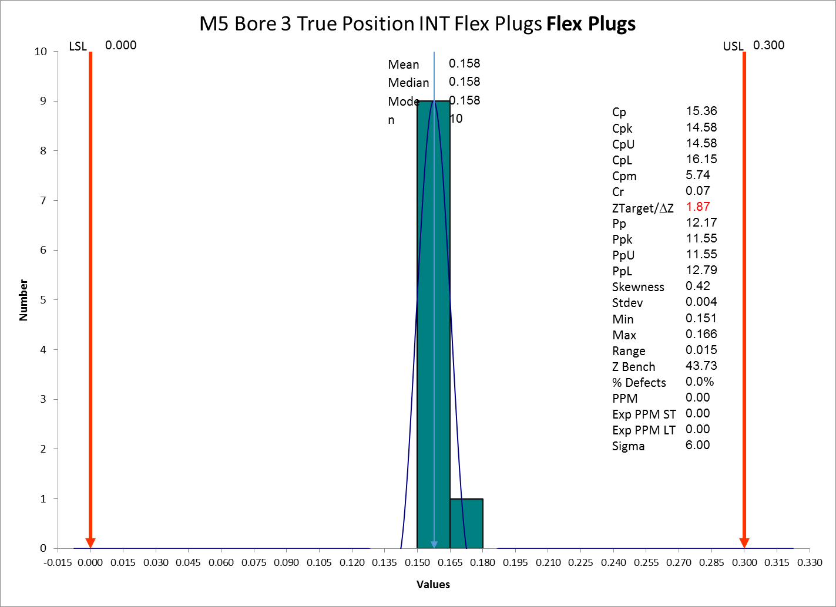
M-5 Bore 3
Here are the results from just bore 3. Measuring on threads resulted in the lowest range and STD.DEV and as well as the highest CPK.

Slide 10
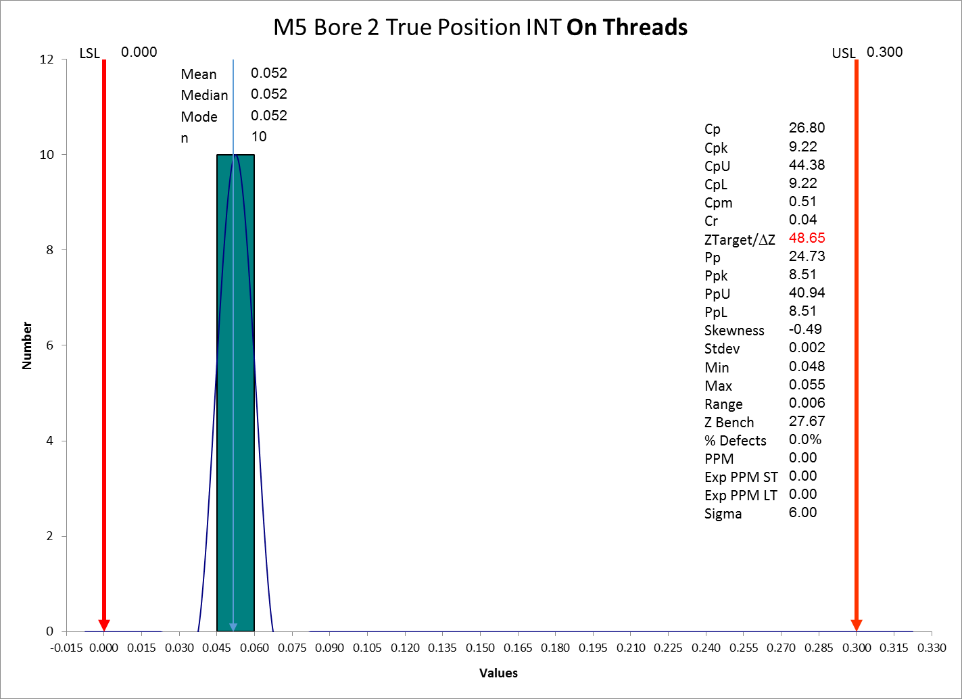
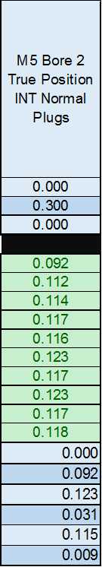
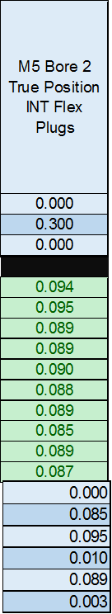
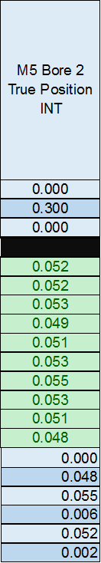
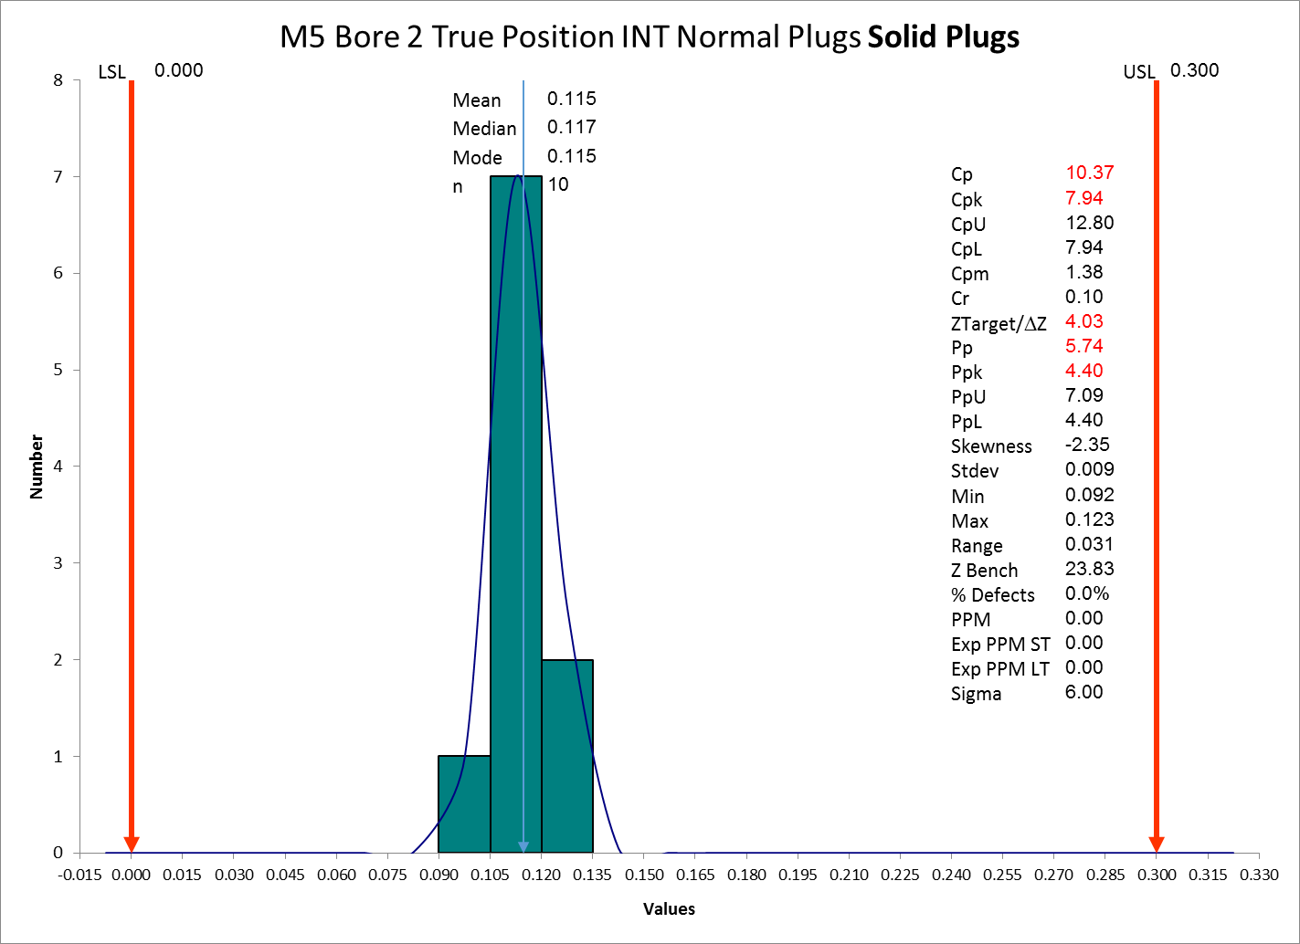
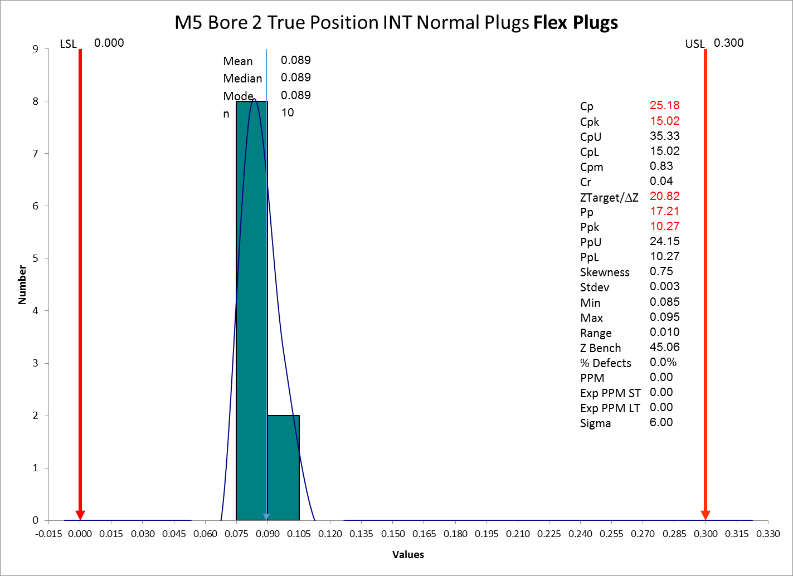
M-5 Bore 4
The next bore showed the same trend. Since true position is not a normal distribution, CP was reported as well. Measuring directly on threads resulted in the best range, STD.DEV, CP, and CPU.

Slide 11
Results
The results showed that measuring on threads had better repeatability for all 4 bores that were studied.
The results from this study match the expected results and match with the previous study at Ellison Technologies.
I propose doing a position study on the MQB compressor housings using the measuring on threads strategy. Currently, we do not have much data on this feature since it damages the position plugs.

