Slide 1
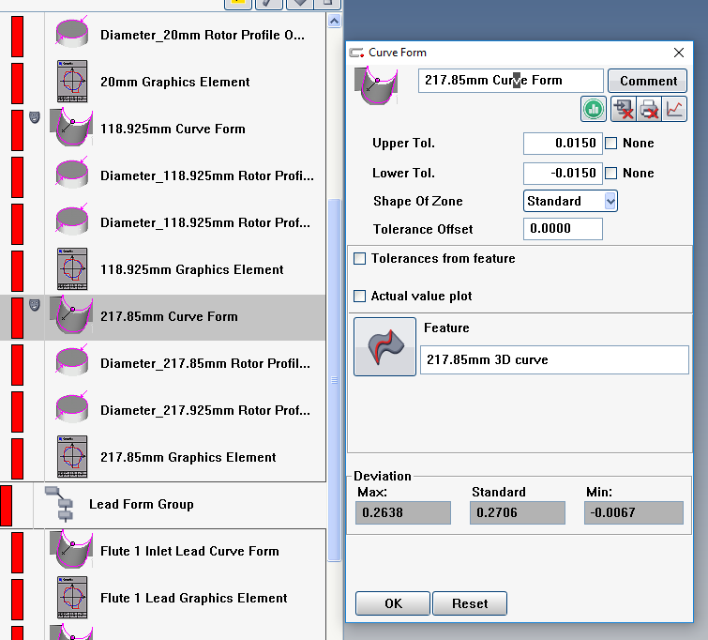
This is my curve form. I don’t
Want it to print or display so I mask
It and make sure these boxes are
Red X’d.
On this specific program
I have not checked the “Hide” box in
Multiple printouts. So masking
And checking these boxes should be
The only thing controlling if they
Display/print or not.

Slide 2
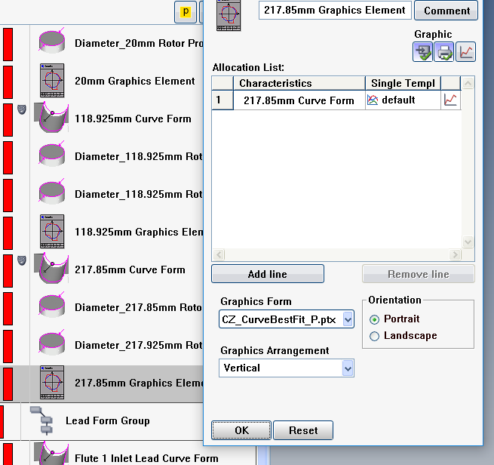
I like the graphic element better so I use
It to output my curve for graph. No masking
And I make sure these are checked.

