Slide 1
3D Curve
Point Masking
Editing Scan Path
Segment Splitting
Recall points from Curve

Slide 2
3D Curve
A curve feature is different from all other curves in many ways. As a result programming techniques that work well with other types of features cause problems when applied to curve.
It is helpful to think of a curve as a group of features instead of a single feature. For example if a Curve is created using 100 nominal points you will receive 100 results.
For each nominal point or result that you intend to measure you should measure between 3-4 points to get consistent reliable data.
For a curve that is created with 100 nominal points you will want to scan 300-400 points of data.

Slide 3
3D Curve
Additionally the actual curve data points are evaluated at ball center location and are NOT corrected for the probe radius offset.
The nominal curve value that gets evaluated is evaluated at the touch point location.
As a result this can make Recalling feature points, masking feature points and evaluating feature data very confusing.
Additionally there are very limited options available when editing the inspection strategy, and the options that are available do not work the way other features behave.

Slide 4
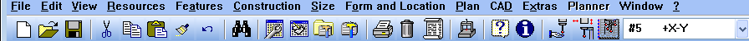
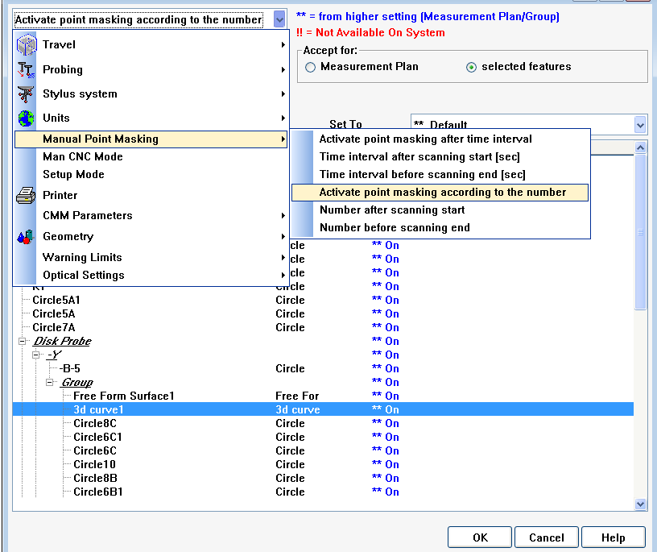
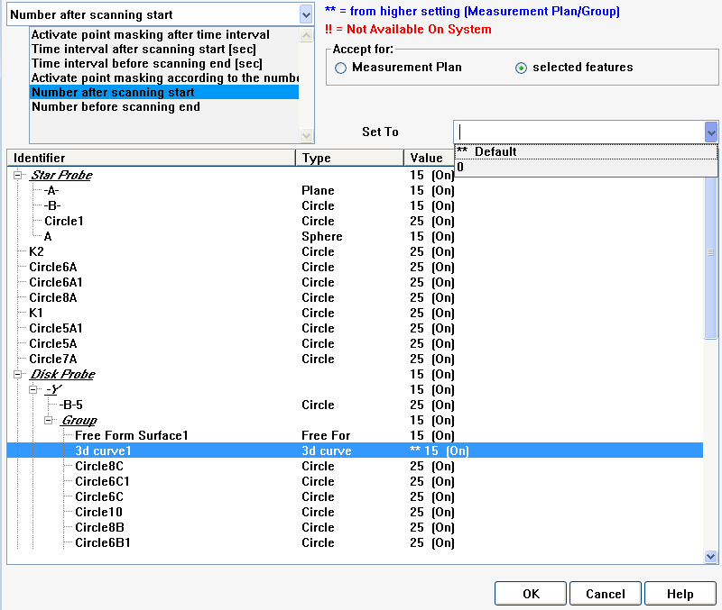
3D Curve
Point Masking
Traditional point masking will not work with curve features.
Define Point Masking according to time or number of points must be turned off for data to be reliable.
Define number of points or time interval to mask from inspection.

Slide 5
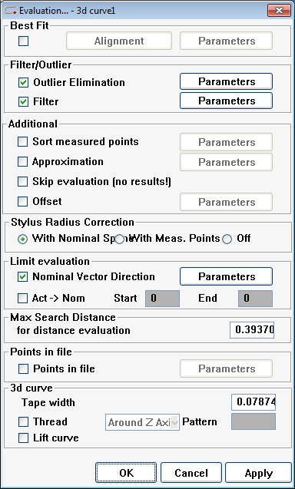
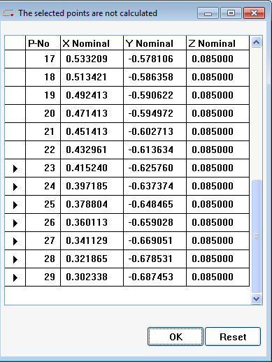
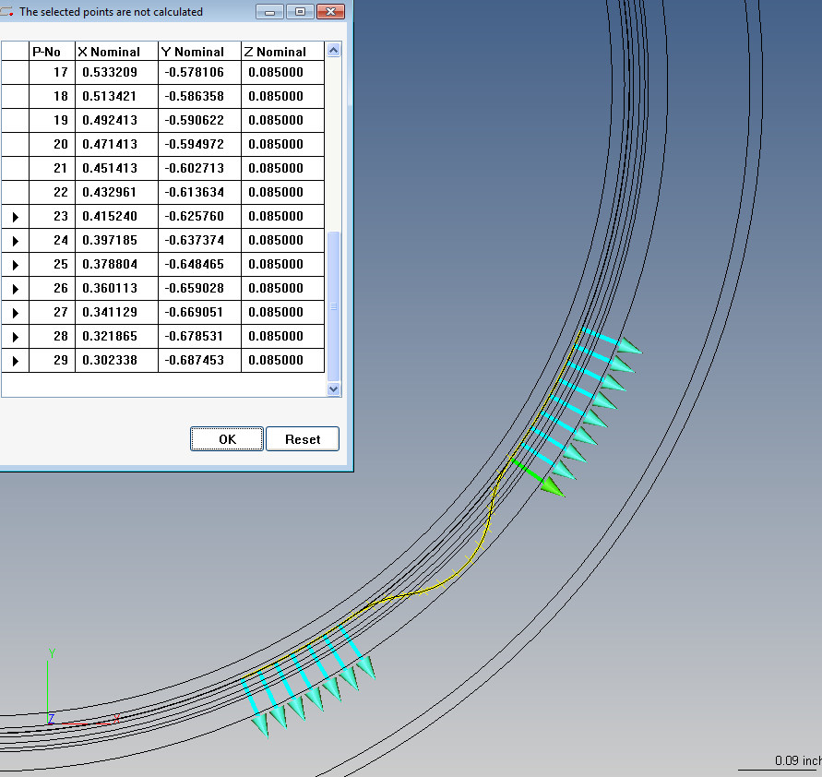
3D Curve
Point Masking
Since traditional point masking affects data points and curve evaluates nominal points, traditional point masking will not work with Curve features. The “Limit Evaluation” option should be selected instead.
Hold down the control key to select multiple points to mask.
Note: Points can be masked from any section of the curve not just the beginning and end of the scan path.
Points that will be masked appear turquoise while the yellow X’s represent the points that will be evaluated. The green point indicates the first point that will be evaluated.
Select the check box for Nominal Vector Direction and click on the Parameters button.

Slide 6
3D Curve
Note: Point masking is necessary because there is error in the beginning and end of a scan. This is because the numeric controller has difficulty adjusting to the change of acceleration / deceleration that occurs as the probe begins to move and begins to stop while data is being collected.
Note: The number of points it is necessary to mask is directly related to the speed you are scanning.

Slide 7
3D Curve
Note: Point masking is necessary because there is error in the beginning and end of a scan. This is because the numeric controller has difficulty adjusting to the change of acceleration / deceleration that occurs as the probe begins to move and begins to stop while data is being collected.
Note: The number of points it is necessary to mask is directly related to the speed you are scanning.
Point Masking
Deleting Points
Segment Splitting

Slide 8
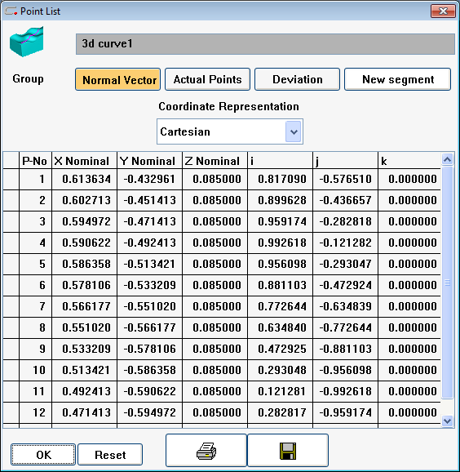
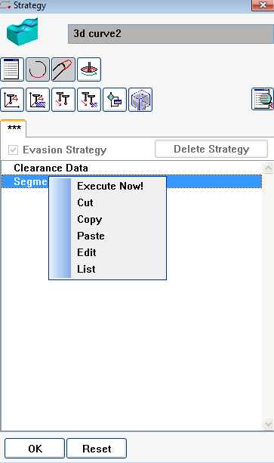
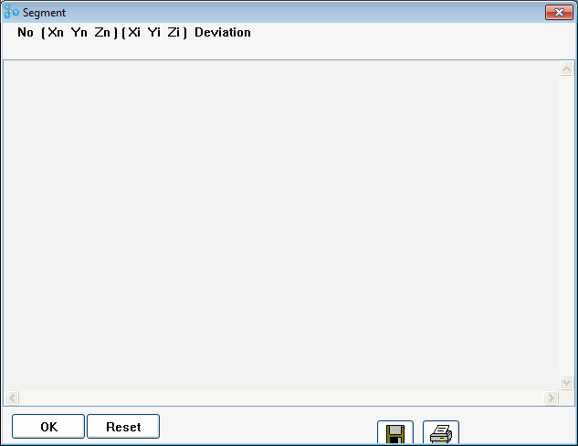
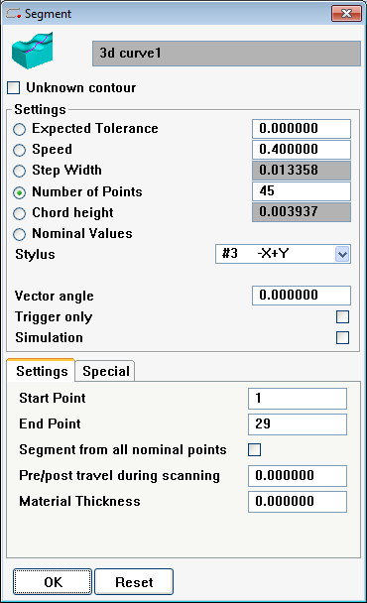
3D Curve
Editing Scan Path
Scan path can not be edited in the strategy window.

Slide 9
3D Curve
The Point list window allows you to view and copy sections of the segment, but you can not delete or edit the values in this window.

Slide 10
3D Curve
???
Not sure what this ones all about…
???

Slide 11
3D Curve
Here you can edit the speed settings, point density, stylus selection and various other options, BUT you can not modify the nominal scan path.

Slide 12
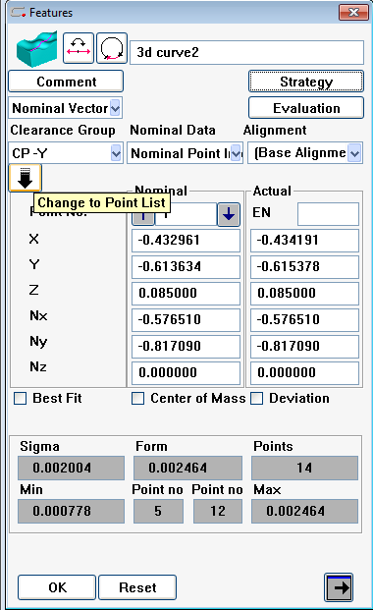
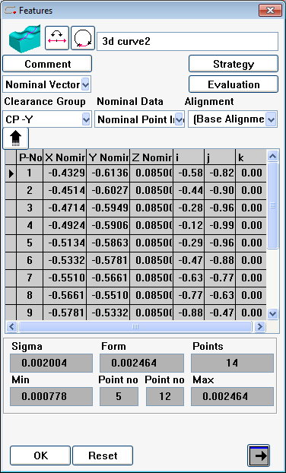
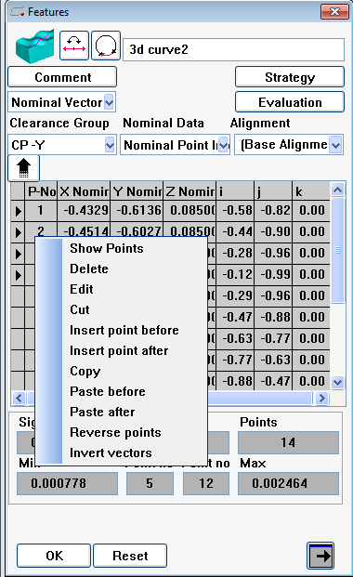
3D Curve
To change the scan path you must edit the nominal curve points.
In the main feature window select the change to point list button as shown.
Select the point(s) that you wish to edit
Right click to bring up the edit menu and select the option you wish to use.

Slide 13
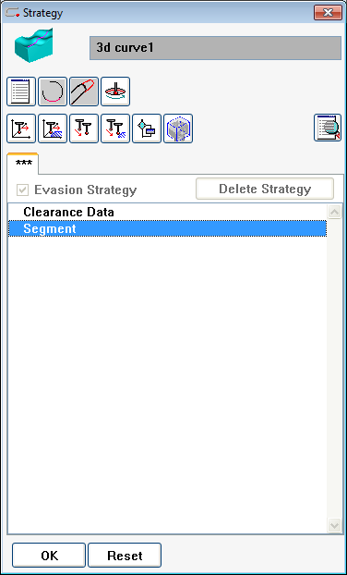
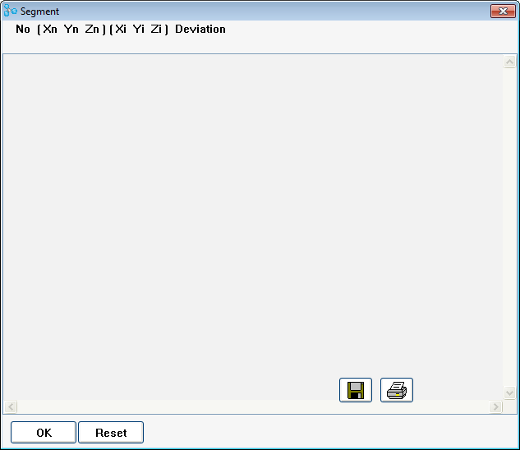
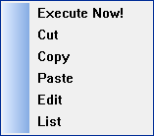
Curve
Segment Editing
Editing segments of a scan strategyy for a curve works different from most features.
Double clicking on the strategy window brings up a window that allows you to control scan speed and point density as well as probe selection but does not allow you to edit the scan path.
Right clicking on the segment brings up a menu with no options for editing the segment.
The “List” option brings up an empty window.

Slide 14
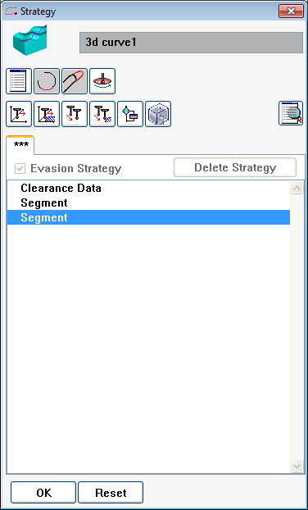
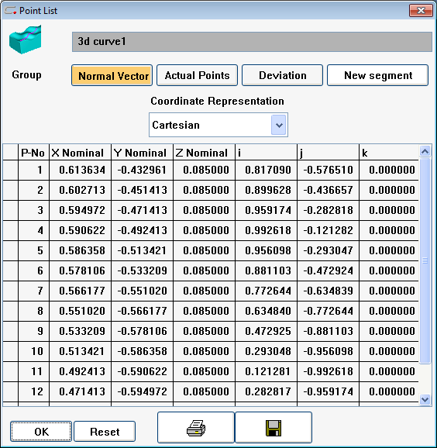
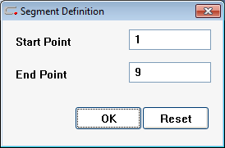
Curve
Segment Editing
Single click on the segment to highlight it then select the point list icon
Use the control key to select multiple points from the point list and select the new segment button.
A window appears to confirm the selection of points that you have made – click OK.
Edit the scan settings accordingly for the new segment in the segment window that opens and click OK.
The new segment will appear directly below the original segment in the strategy window.

