Slide 1
LIMITATIONS OF MEASURING A SMALL ARC/RADIUS ON A CMM.
A radius is a straight line from the center to the circumference of a circle or sphere.
CMM’s do not measure small arc’s or radius’s well if the exact center location or exact radius size is not known because, such a small section of data is collected.
Mathematically, if you knew the circumference of a radius, you could calculate the radius using the circumference divided by 2*pi but, CMM’s don’t measure circumferences well either.
This PowerPoint is intended to help improve the accuracy of measuring a radius on a CMM . However, it is IMPORTANT to mention that the methods used are limited to many variations caused by the filtering and size evaluations used and the accuracy of the CMM.
CAUTION AND THOROUGHNESS SHOULD ALWAYS BE EXERCISED.

Slide 2
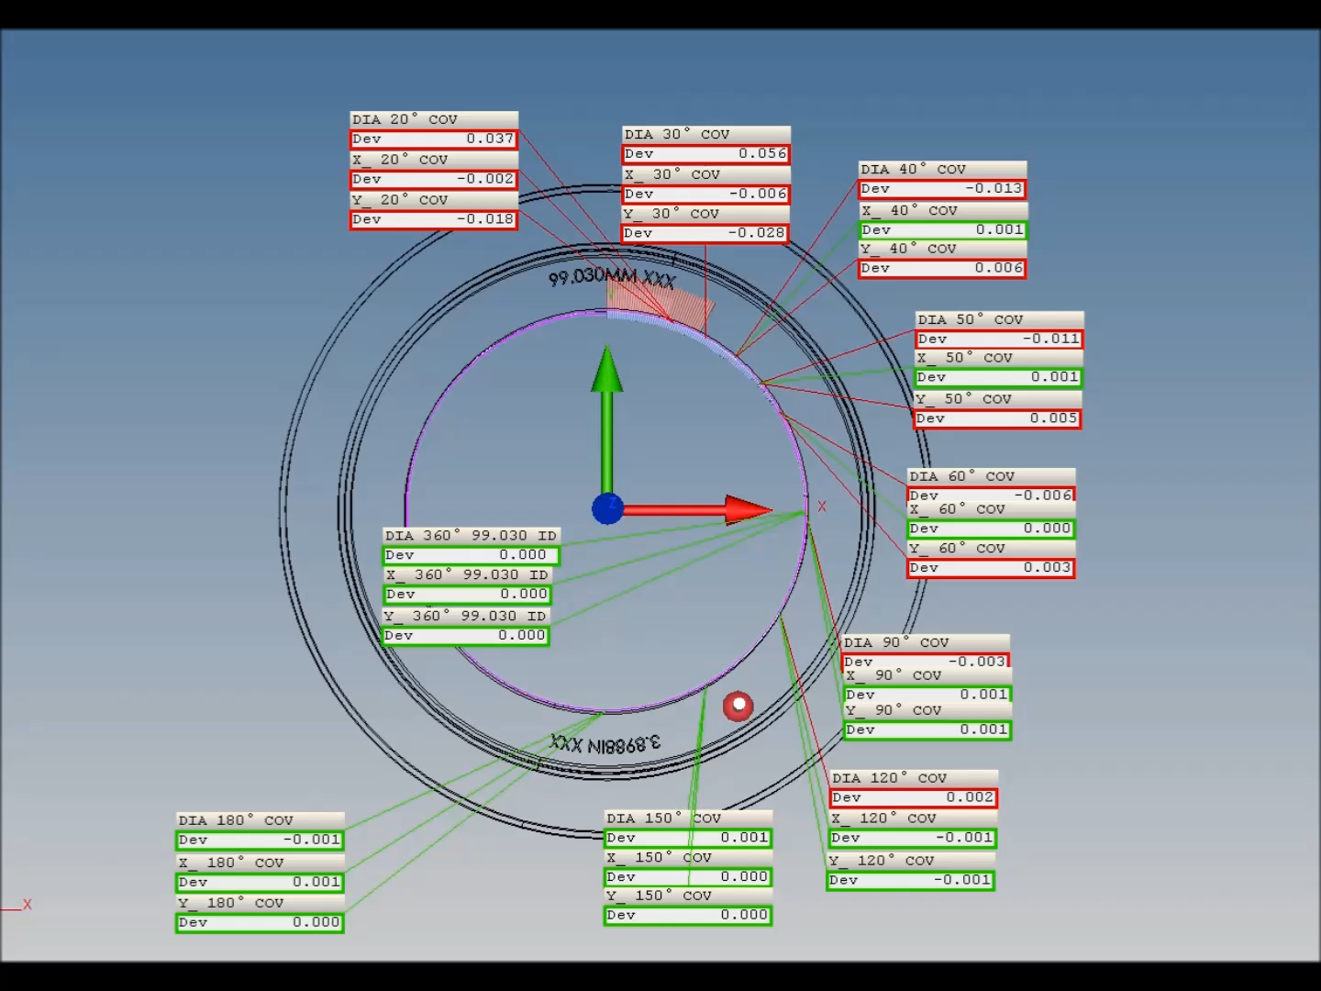
In the video example to the right, a 99.030mm XXX I.D. ring gauge is first measured a full 360° to verify the CMM is measuring it correctly and to use the center of the gauge as Datum’s for the CMM coordinate locations.
After the full 360° measurement, the ring gauge is measured in small arc sections using 9 different segments of 20°,30°,40°,50°,60°,90°, 120°, 150° and 180°. All of these segments are measured with the same center Datum and without the ring gauge being moved.
As you can see in the results, the CMM did not measure the gauge ID correctly until about 150° of scan coverage .
This is done on a master ring gauge with very little to zero form error. If the same measurement was done on something with a rougher surface finish or out of roundness, the correct size or location most likely wouldn’t have been obtained until at least 180° of the gauge was measured.

Slide 3
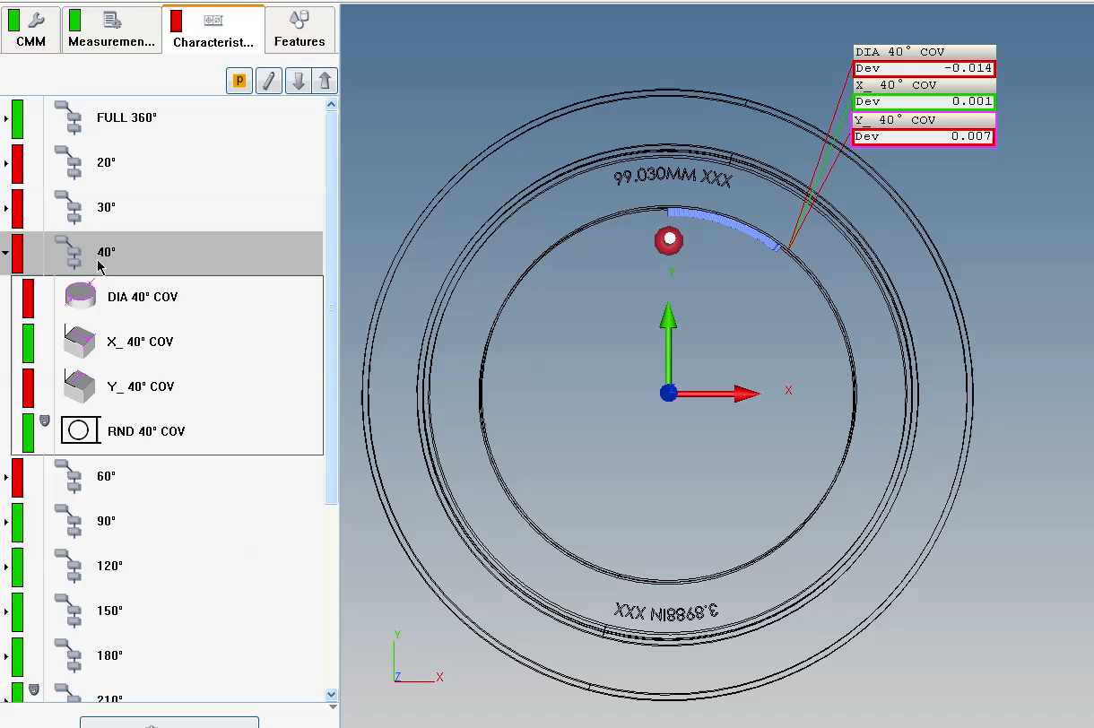
In this clip, I will show you how to help the CMM make corrections for the size and location of such small arcs.
(Click to play the video )
Small Radius's, less than 180 degrees need to be constrained for the CMM to know how to calculate them more accurately.
Basically:
If you are looking to measure a small a radius, then constrain location.
If you are looking for a location finding, then constrain size. Then test. Then test some more to ensure repeatability.
If the form, size, and location of the feature aren't repeatable because of the of bad form (roundness, surface irregularities), then single points are probably the best solution because it takes filter errors out of the equation.

