Slide 1

Connect Segments
idHKe
Application
OKO, 2019-09-05

Slide 2
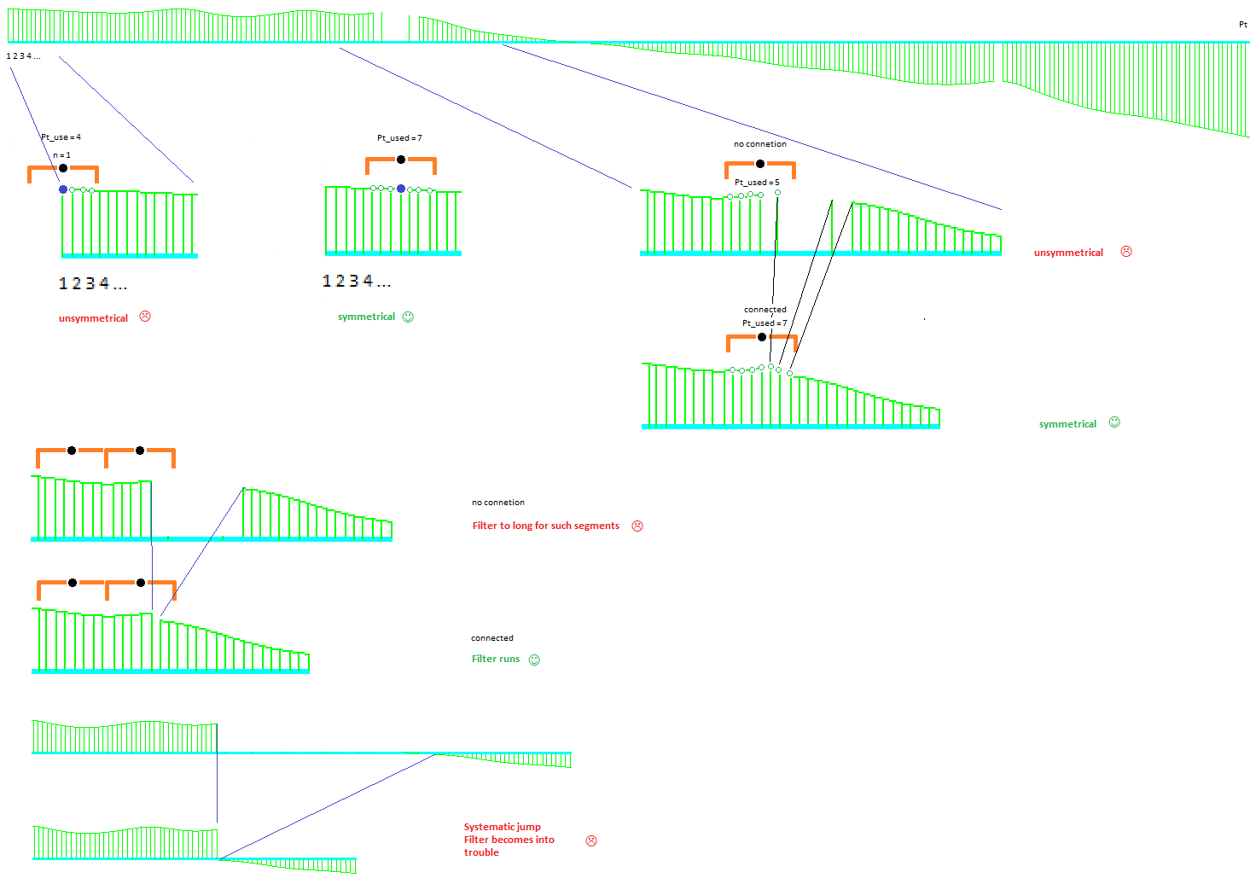
Overview

Slide 3
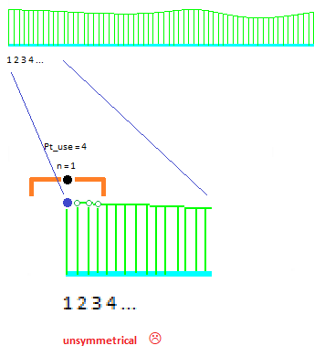
Start / End behaviour
At start and end at an open contur
Unsymmetrical point distribution until filtered actual is greater then Lambda / 2
CutOff at roughness
Do not appear for closed path

Slide 4
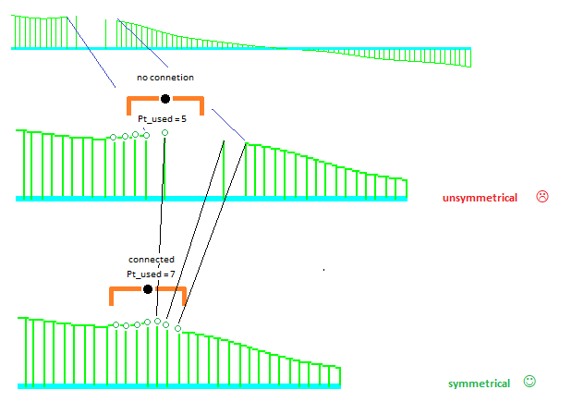
Outlier
Same effect as at start- end
Solved by connect segments
➔ Outlier

Slide 5
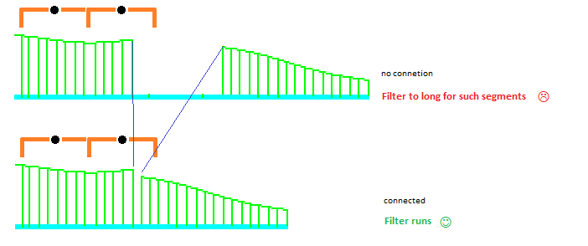
Segments << 2 * Lambda
Without „connection“ filter will not work
Solved by connect segments
➔ Works well for unsystematic segments

Slide 6
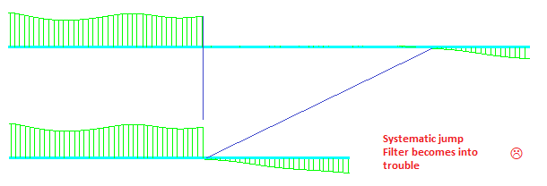
Systematic deviation
If the segments obtains a systematic behaviour at start or end also there is a „jump“ from segment to next, the filter comes into trouble when „connection“ is activated.
It will be better to addapt the Lambda related to the length of the shortes segment.
Other examples
Cylinder / Plane by circular sections and shape lines
Point step is different

Slide 7
Summary
Standard Elements (Line, Plane, Circle, …)
„Connect Segments“ will help for some issues
At „special“ situations it must be varified
For calulation the „gap“ will be closed
The output is visualized with the „gaps“
Not available for Curve

Slide 8


