Slide 1
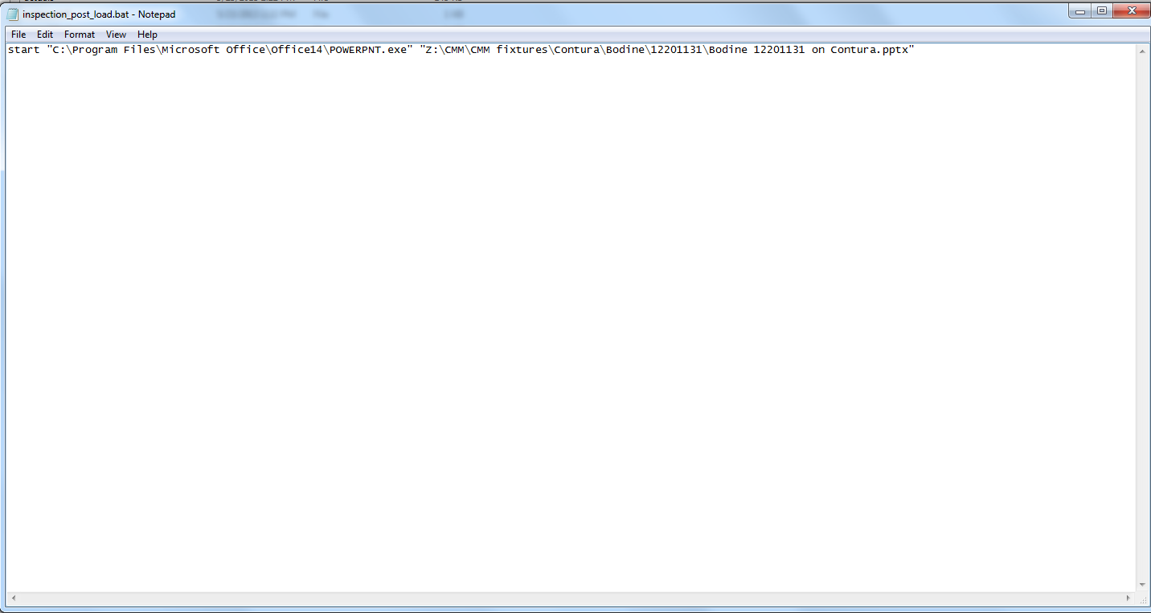
Open up a blank note pad and type in a command like the following.
Path to Microsoft office power point
Path to Microsoft office power point presentation
Save this file in the program’s folder and name it: inspection_post_load.bat

