Slide 1
Vast XT gold

Slide 2
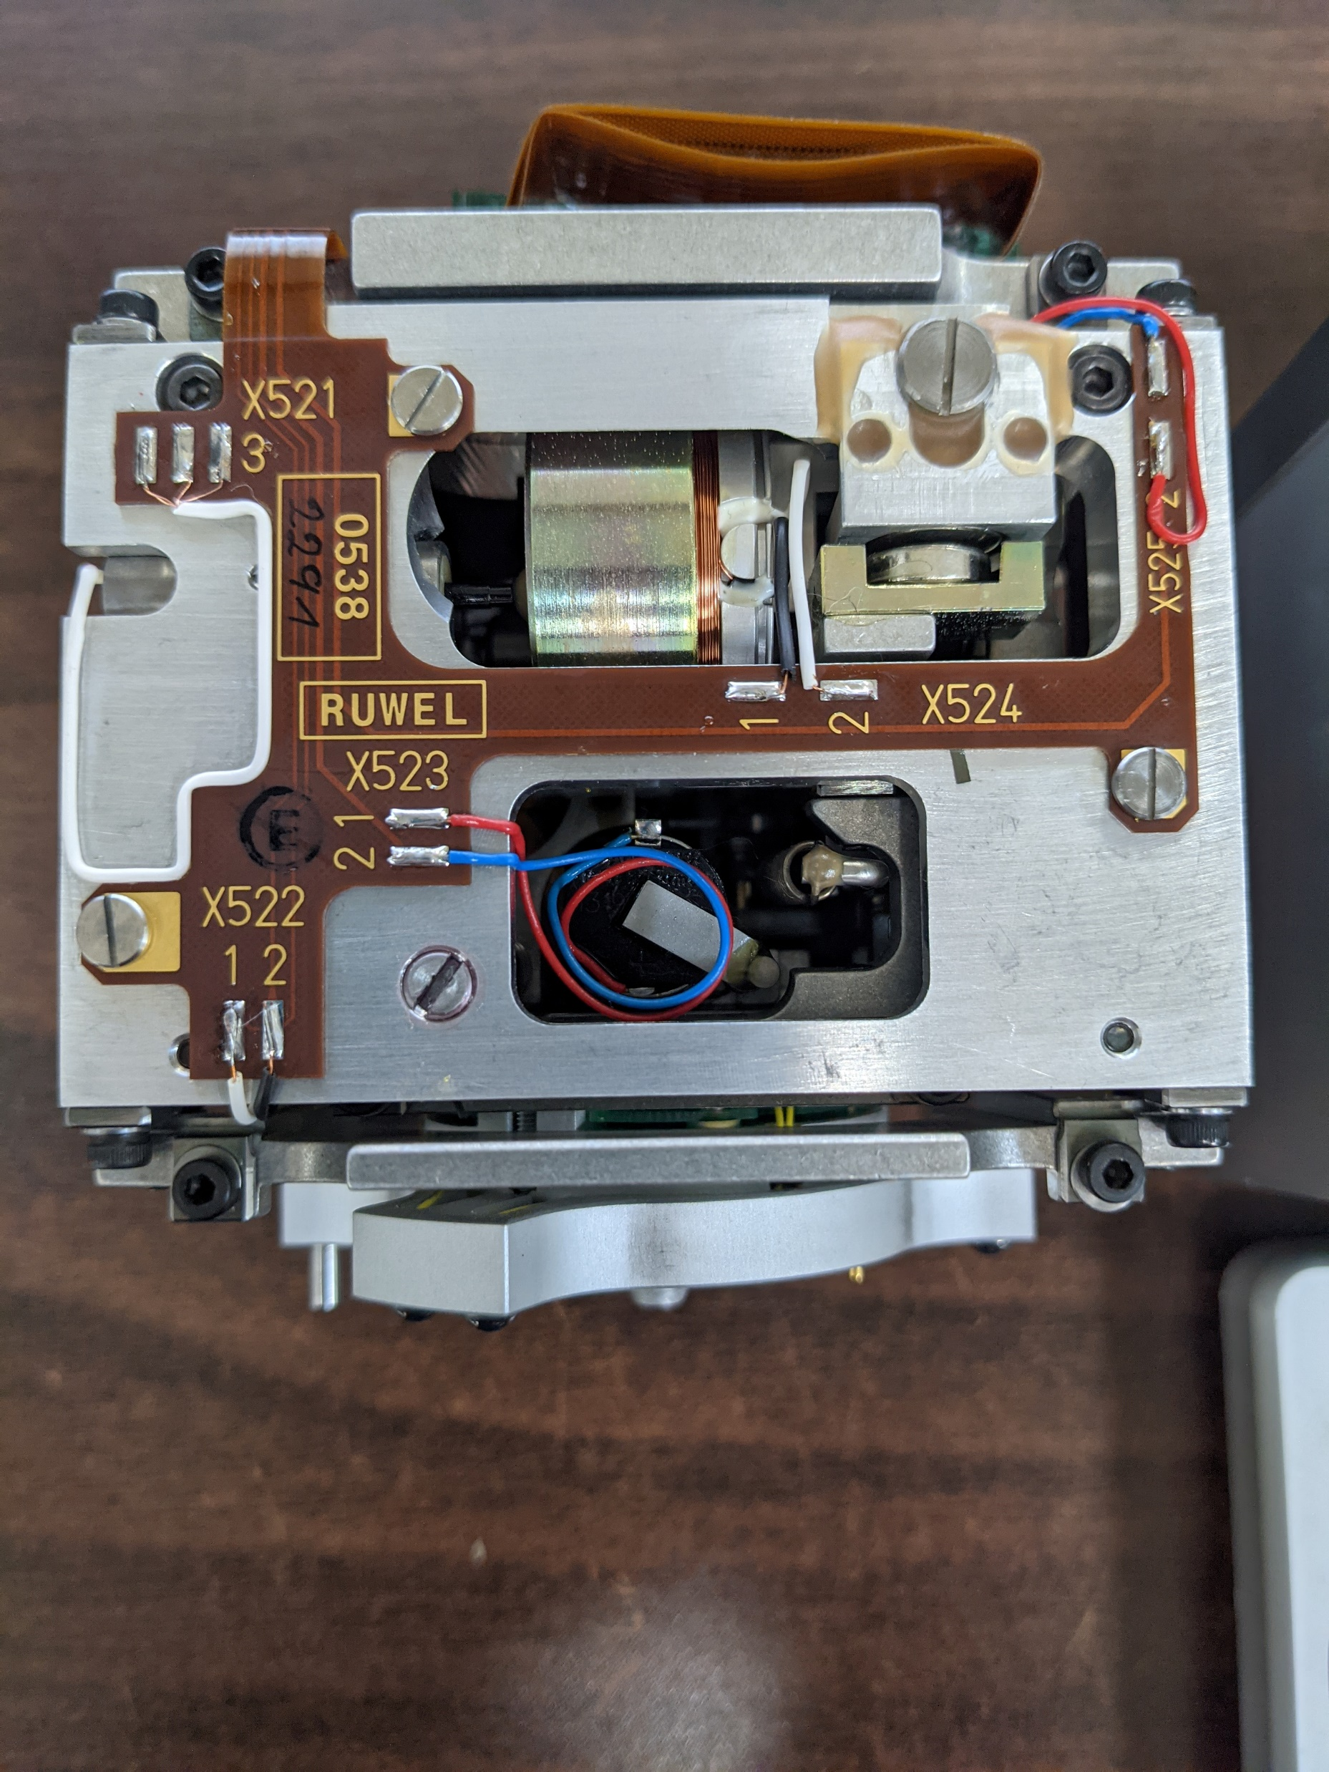
Skeleton side -Y

Slide 3
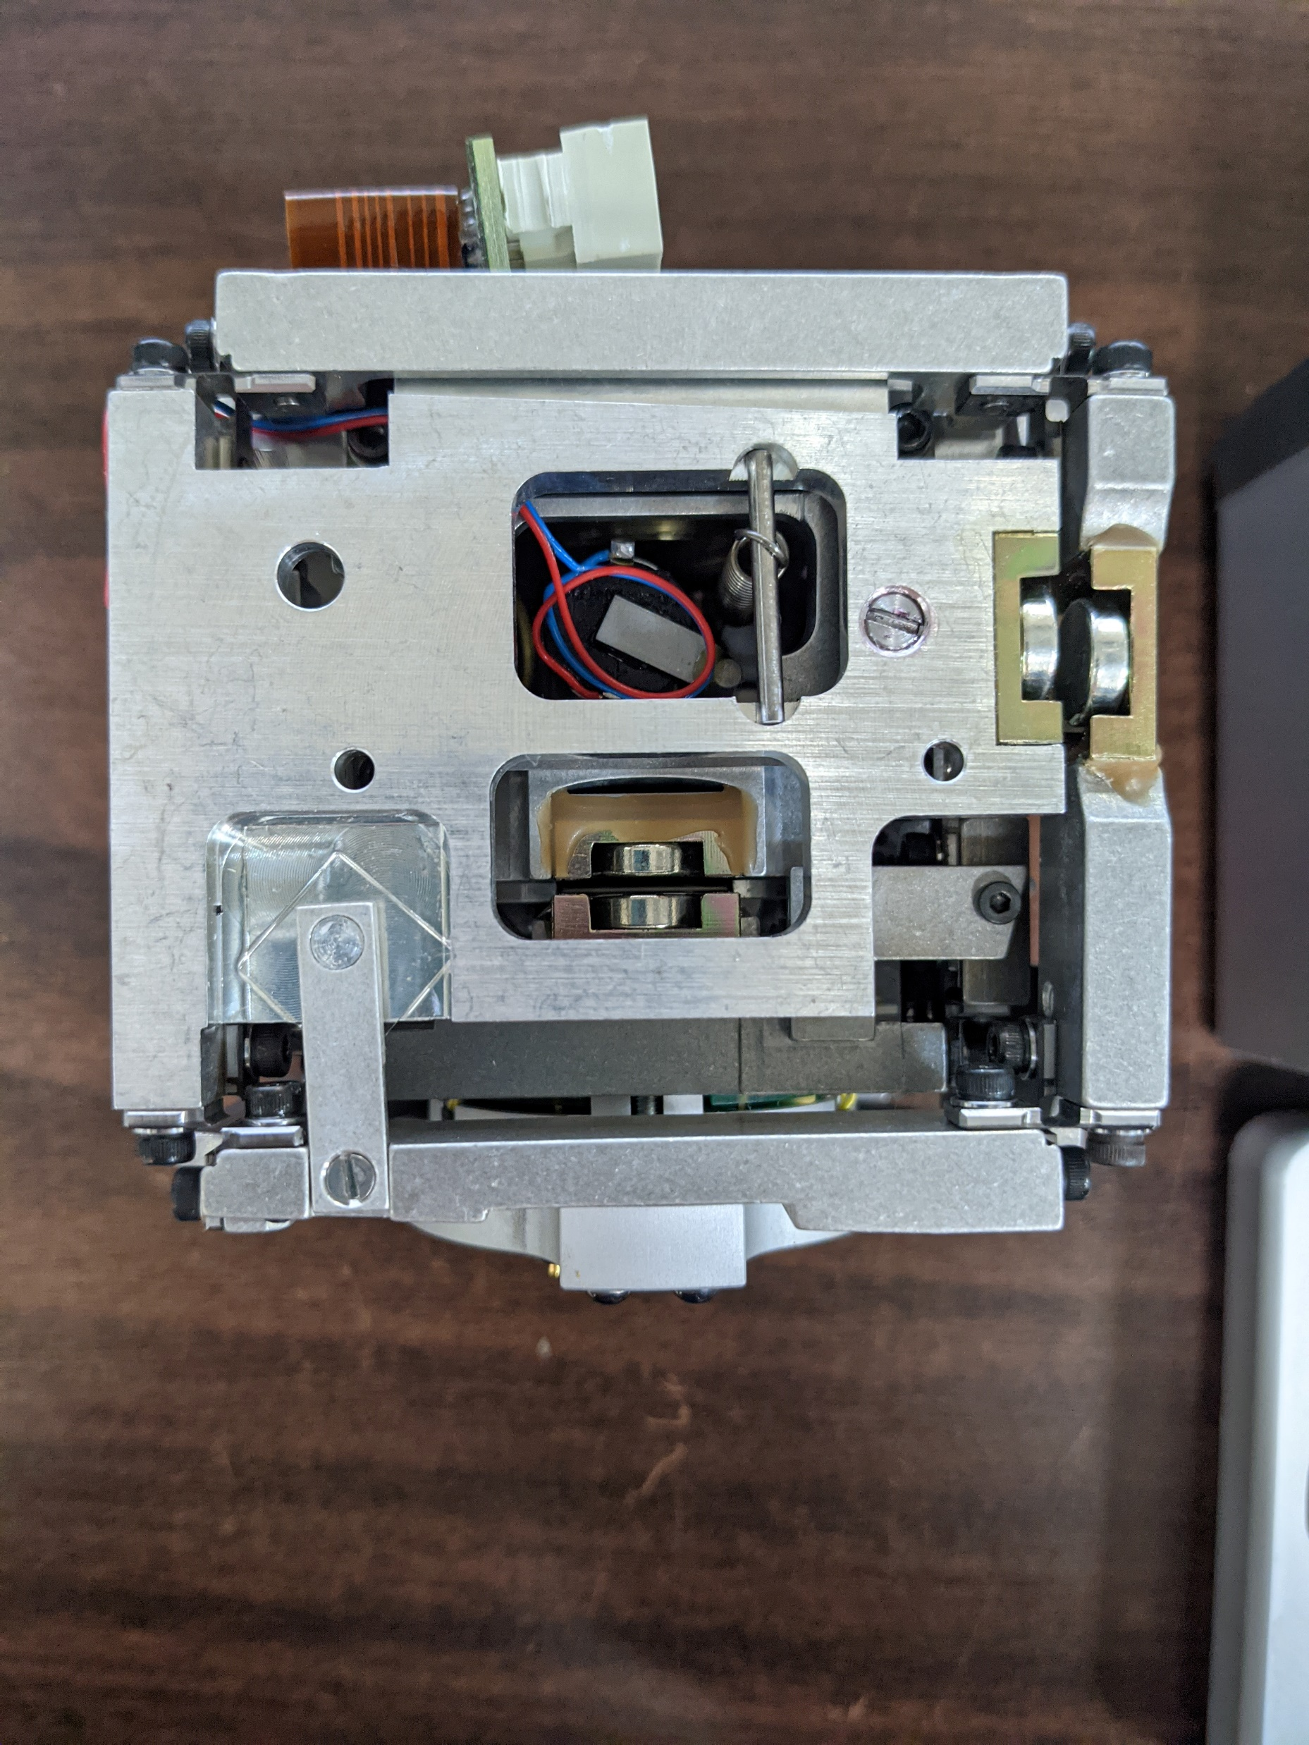
Skeleton side +X

Slide 4
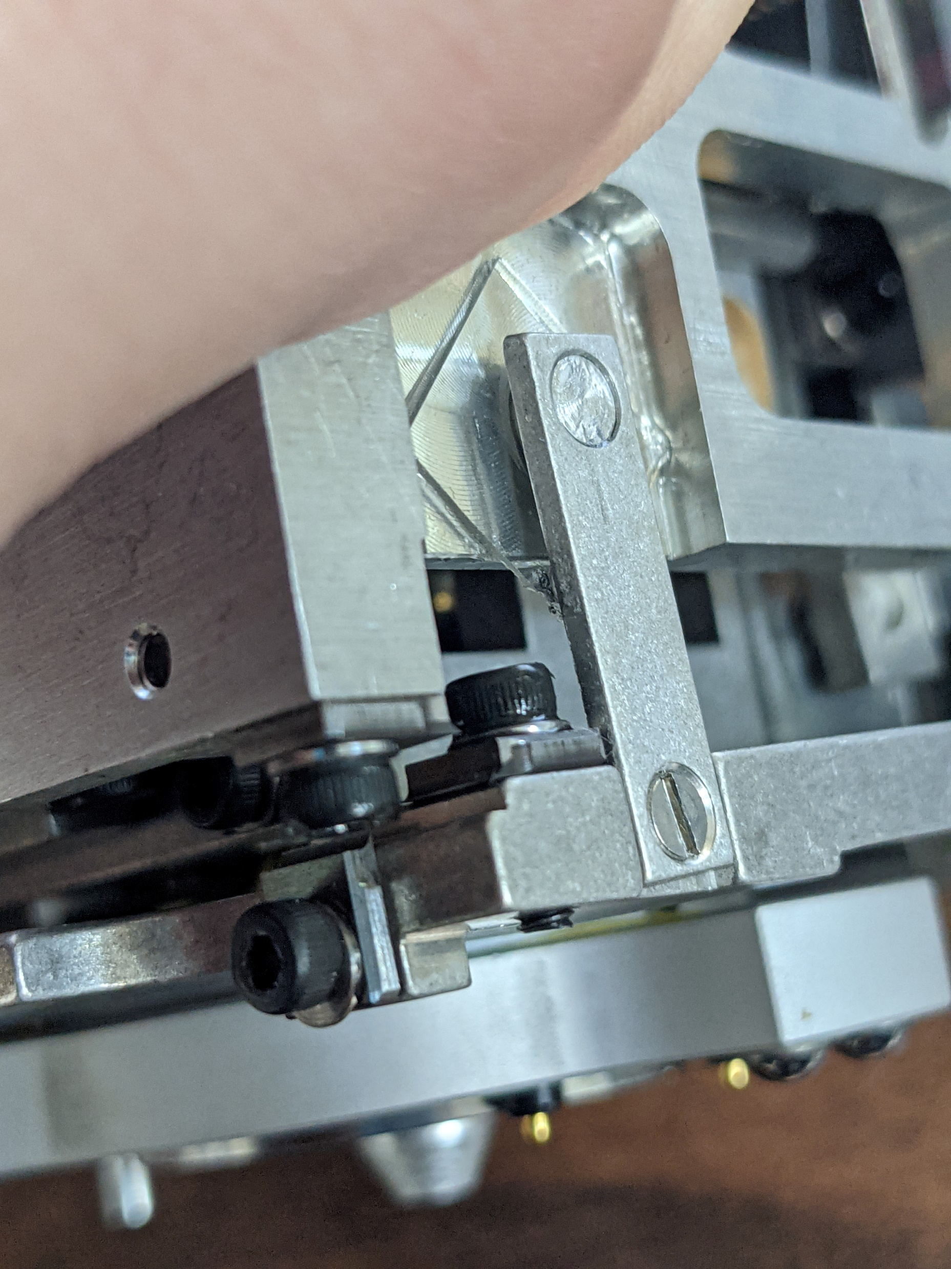
Fail Area, +X Side bottom Left
A leaf-spring had failed and broken into two pieces.

Slide 5
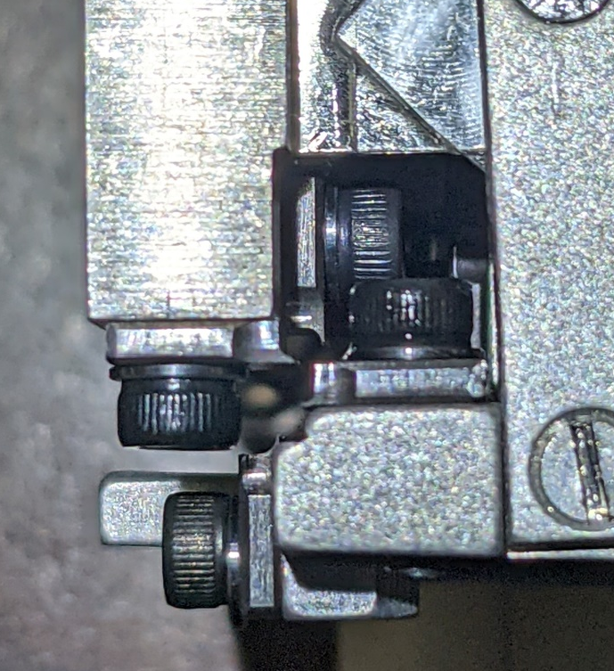
Fail Area, +X Side bottom Left
There is 4 springs in total that broke. 2 springs in each corner.
This broke in bottom left of +X side & Bottom Right on –X side.

Slide 6
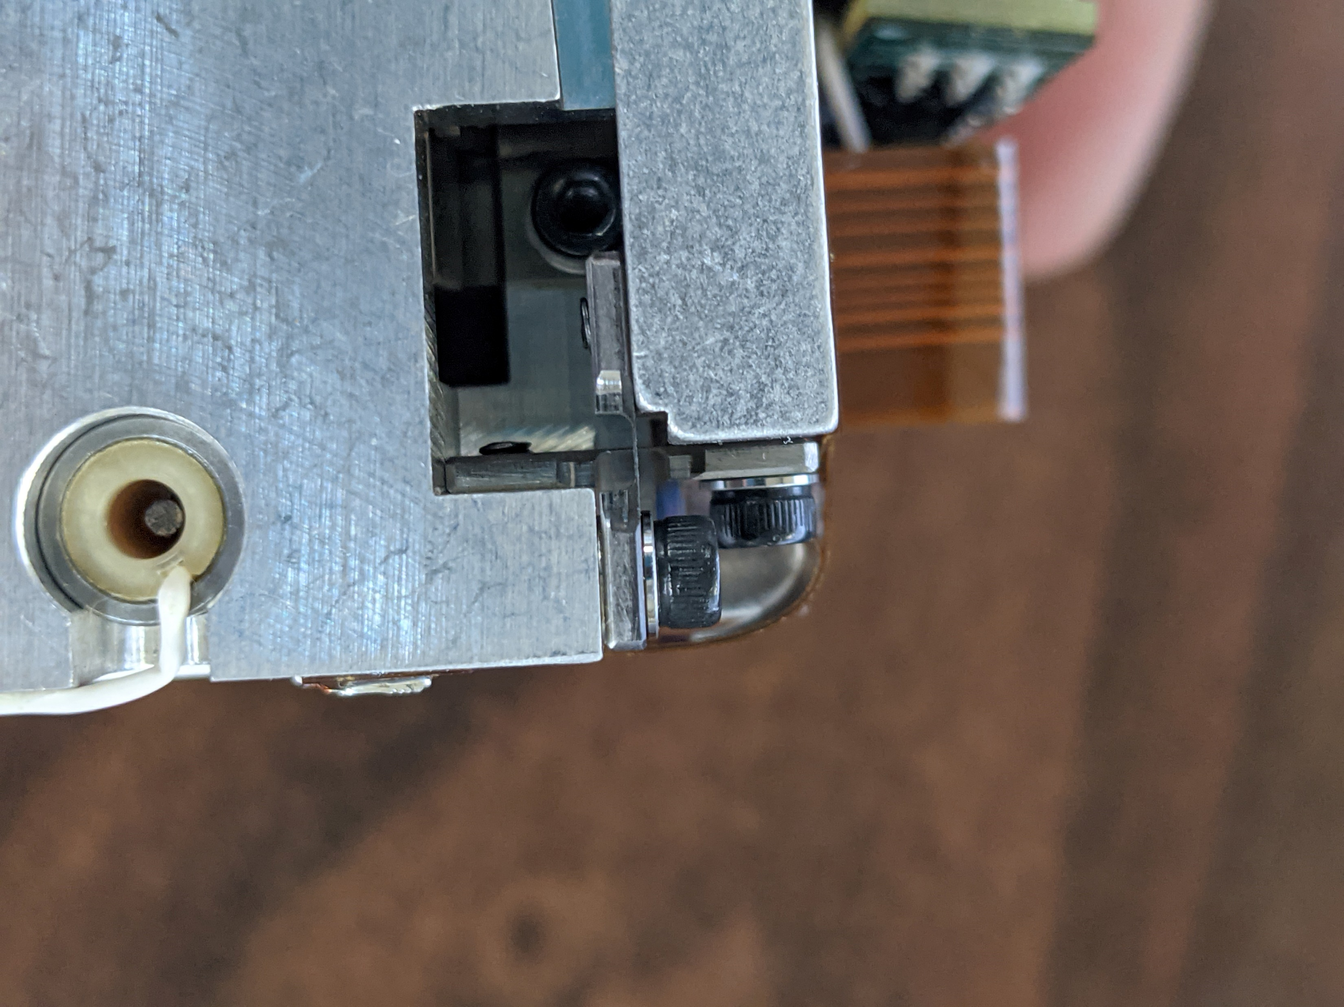
OK Area, -X side Top Right
An OK condition showing both leaves attached.

