Slide 1
Aligning to a Gear Spline
In many cases our customer’s prints call out for the gear spline to be used as a datum feature. While the inspection of the gear’s index(pitch) measurement can be evaluated with eccentric correction, this data cannot be called back into Calypso to be used as a datum.
What we are able to do is simulate the method used in GearPro to locate the gap between the gear teeth to set our Planar Rotation for either the Base Alignment or a Secondary Alignment. Then with this alignment we will be able to create a circle from self-centering points or a cylinder from self-centering lines on the gap between the teeth.
In this example we will do the more difficult method using the Base Alignment and creating a Cylinder from the gap between the teeth. I will also be using a CAD model but please remember this will be the same even if you do not have a model.

Slide 2
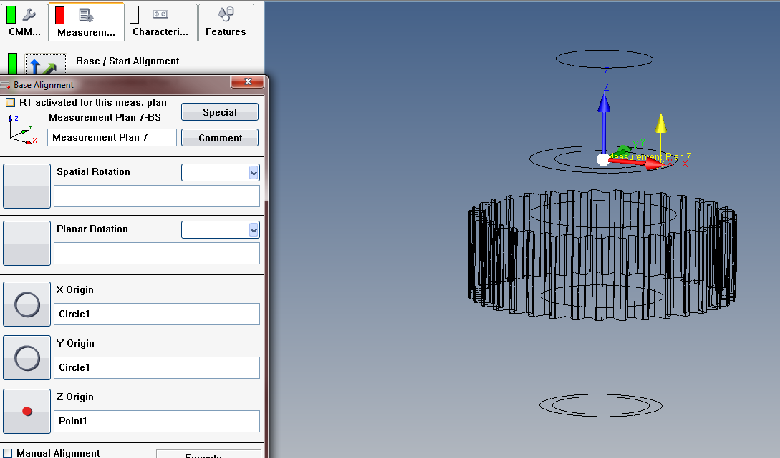
Aligning to a Gear Spline
First we will load our CAD file and build a “simple” Base Alignment. The key here is to have the X and Y origin in the center of the gear. I will be using a Point on top of the part and a Circle around the shaft.

Slide 3
Aligning to a Gear Spline
Now we will start building the Planar Rotation. This will be done by creating a Point on the Major Diameter of the gear, on a tooth in the +X Axis.

Slide 4
Aligning to a Gear Spline
We will then Pattern the Point around the gear, the idea here is to have one point hit the top of the gear tooth and have one point hit the gap between the teeth. If we were to create the pattern for the number of teeth, then all out points would be on top of the gear teeth. So instead we will pattern the point for (Number of Gear Teeth x 2). This gear has 35 teeth so I will create a pattern of 70.

Slide 5
Aligning to a Gear Spline
As you can see there are points now on the gear tooth and in the gap. Since we only need two of the points, one on the gear tooth and one in the gap, we will Exclude all Indexes but 1 and 2.

Slide 6
Aligning to a Gear Spline
Then we will make this a Self-Centering Point. It might be important to “clamp the Z axis”. When self-centering in the gear spline, the probe could “drift” in the Z axis.

Slide 7
Aligning to a Gear Spline
And in the Evaluation of the point we will change it to a Midpoint so there is no influence to the measurement from probe correction.

Slide 8
Aligning to a Gear Spline
When these two points are measured, one will find the gap just like GearPro. To put that one point into our Alignment for the Planar Rotation we will use the Minimum Feature. (Because our probing is in the –X direction we would want the minimum of the two features, if we were measuring an internal gear then we might want the maximum feature).
In the Minimum Feature select the two points from the pattern and be sure to put a check in the box for Alignment From Result and Select the X Value.

Slide 9
Aligning to a Gear Spline
Now we will start building the Datum from the Spline. This will be done with a Cylinder recalling a patterned 2D Line.
Create a 2D Line on the same tooth the Point was created on.

Slide 10
Aligning to a Gear Spline
This 2D Line will then be patterned for the number of teeth, for this example my gear has 35 teeth.

Slide 11
Aligning to a Gear Spline
Keep in mind you can Exclude Indexes from the Pattern. Measuring 35 2D Lines will take a long time and the gear could have a lot more teeth. I tend to exclude all but a hand full of the lines.

Slide 12
Aligning to a Gear Spline
This 2D Line also must be Self-Centering. In the Strategy of the feature you would use the Line Auto Path, be sure to set it up to gather enough points so Filtering will work and Enable Self-Centering Scanning.

Slide 13
Aligning to a Gear Spline
Next you will bring in an empty Cylinder from the Features dropdown menu. In the Cylinder you will use Recall Feature Points to pull in the measured data from the patterned 2D Lines.

Slide 14
Aligning to a Gear Spline
Now that we have the Minimum Feature for the Planar Rotation and the Cylinder for the Spatial Rotation and X, Y Origin, it is time to build the Alignment. Open the Base Alignment screen and select the corresponding features .

Slide 15
Aligning to a Gear Spline
Now you should be asking yourself how this will work since the 2D Lines are set up to be measured on the tooth and not in the Gap. Since we have the Alignment set, we can now open the 2D Line and change the Nominal Y value to zero. This will put the line in-between the teeth.

Slide 16
Aligning to a Gear Spline
The only thing left to do is to Loop the Alignment. Depending on how the part is set up, the first set of 2D Lines could be measured on the teeth and not the gap. The Planar Rotation is not calculated until after the alignment is ran so on the second Loop it will measure all 2D Lines in the gap.

Slide 17
Aligning to a Gear Spline
One more thing to think about when doing this, the Manual Alignment.
In order to manually align this part you would have to probe 2D Lines on all those gaps and that takes too much time, so we will use a Start Alignment. Take the Circle and Point used to create the Base Alignment from when we started this and put those in for your Start Alignment.
Remember that all you need is the X, Y, and Z Origin because they Base Alignment will find the gap.

Slide 18
Aligning to a Gear Spline
* Notes *
* This same exercise can be done on gears with a helix.
* The same exercise could be done using Self-Centering Points instead of 2D Lines, then these point can be recalled into a Circle.
* When using a Rotary Table and only use one probe tip there will be selections to pick from when creating the Pattern. Rotary table position constant = the table does not rotate to measure the pattern. Rotate rotary table as well = the table will rotate with the pattern(this would be used when using the table and one probe tip, like a #5).

