Slide 1
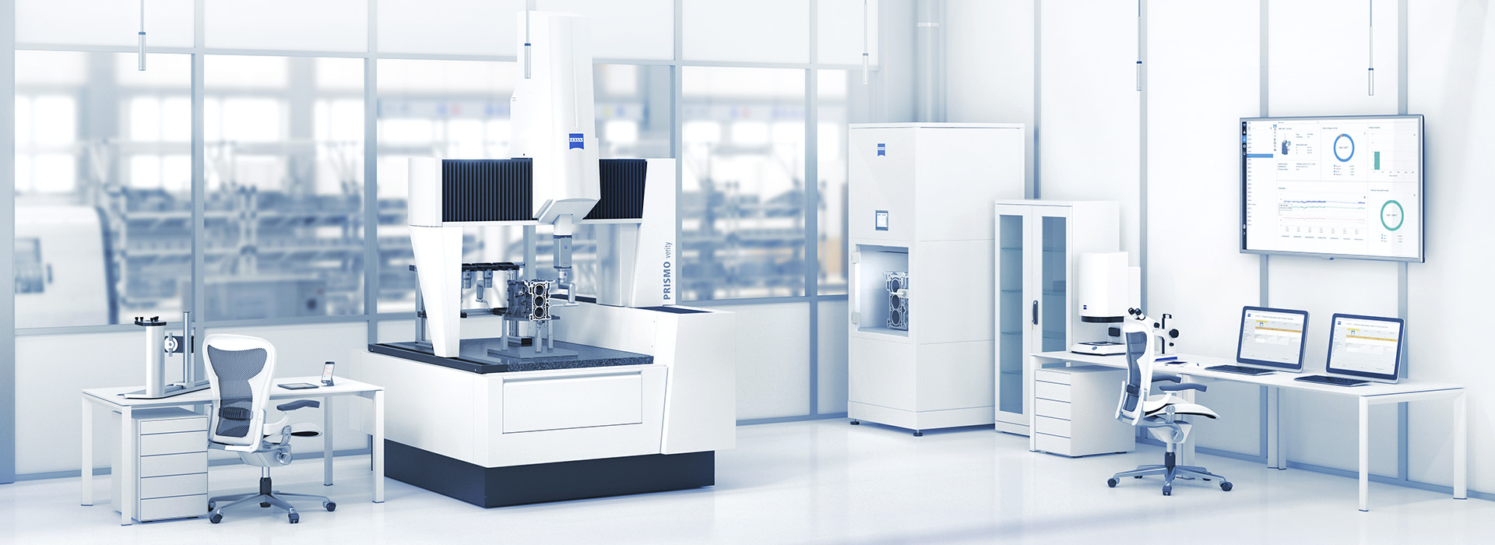
AutoRun
Glenn Grefer
Field Application Engineer
2020-02-09

Slide 2
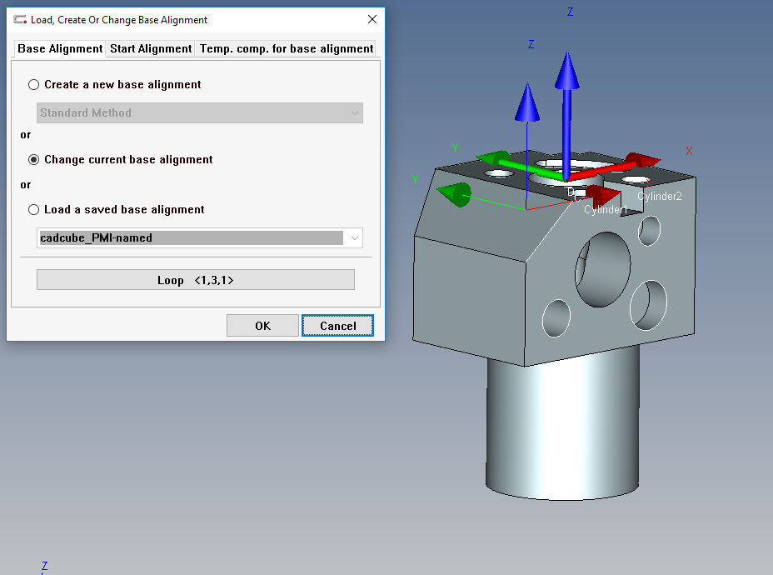
In CALYPSO
Open your Base Alignment definition page and select “Change current base alignment”
1
2
3
4
5
6
7
8

Slide 3
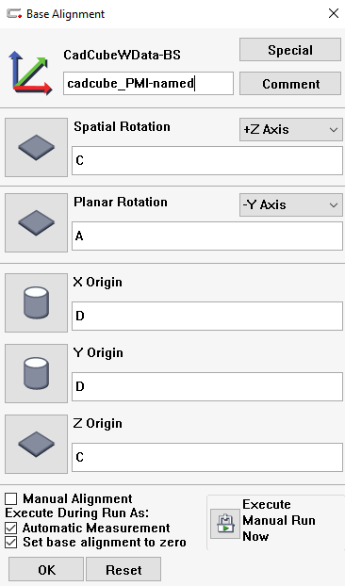
On Base Alignment
Rename your Base Alignment
I just use 1,2,3 etc. but you can call them whatever you would like
Execute a Manual Run Now for each new name, after you change the name, in each location you want to run the part.
We now have an alignment location for each part for our pallet in Auto Run

Slide 4
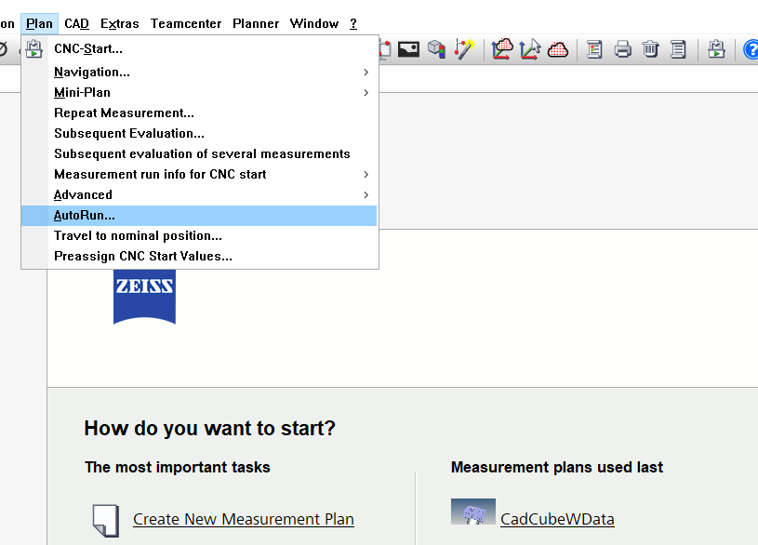
In Auto Run
Save and Close all open programs then
Plan->AutoRun…

Slide 5
In Auto Run
Enter a new pallet
Find your program an open as you would in CALYPSO

Slide 6
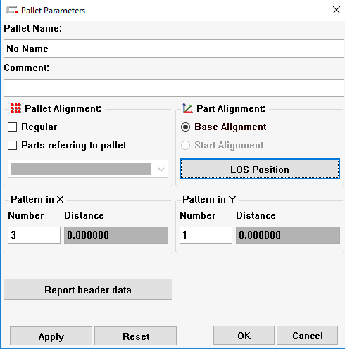
In Auto Run
On the Pallet Parameters screen uncheck Regular and Parts referring to pallet
Enter your number of Parts
Then Press the LOS Position

Slide 7
In Auto Run
Enter your new Alignment Locations for each part

Slide 8
In Auto Run
We now have a new Pallet that is dependent on the saved alignment that we created in CALYPSO

