Slide 1
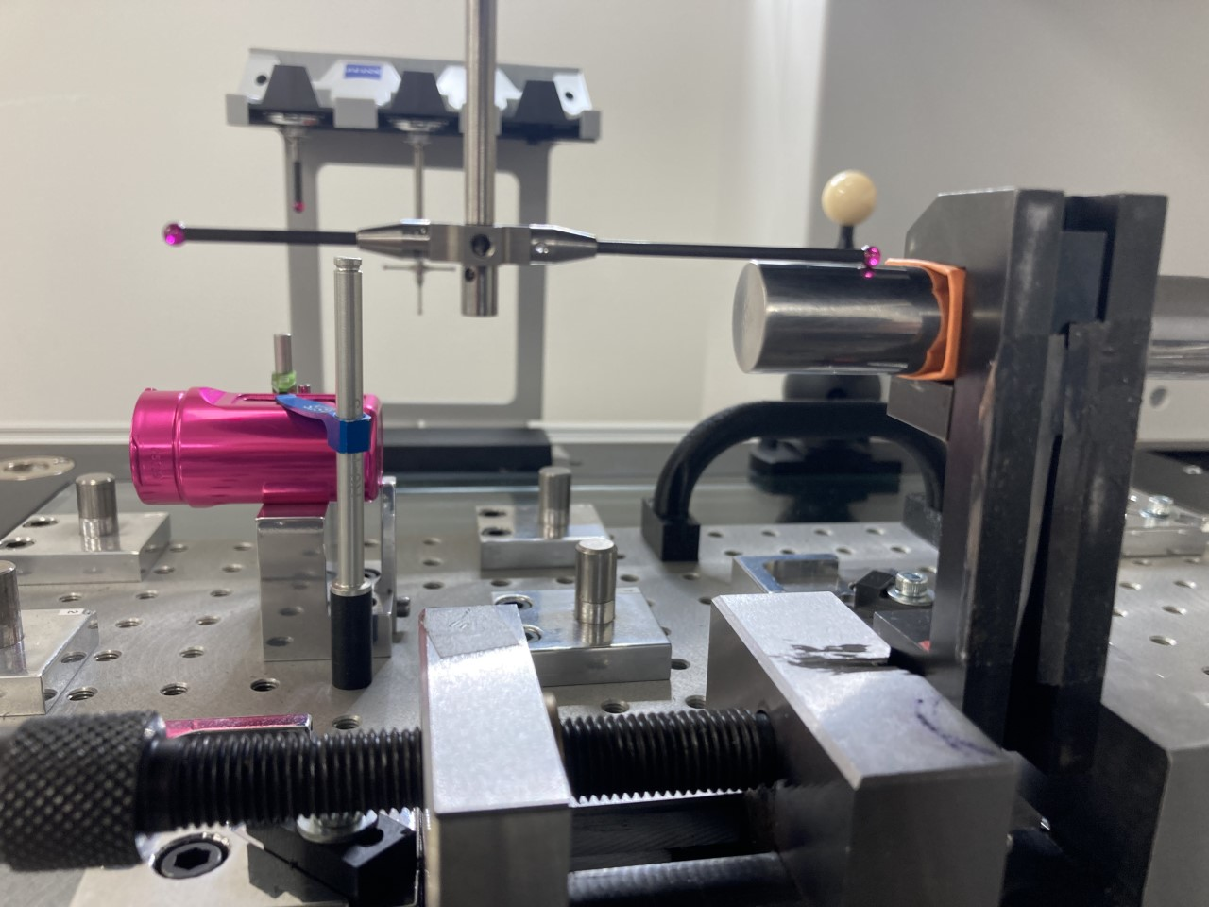
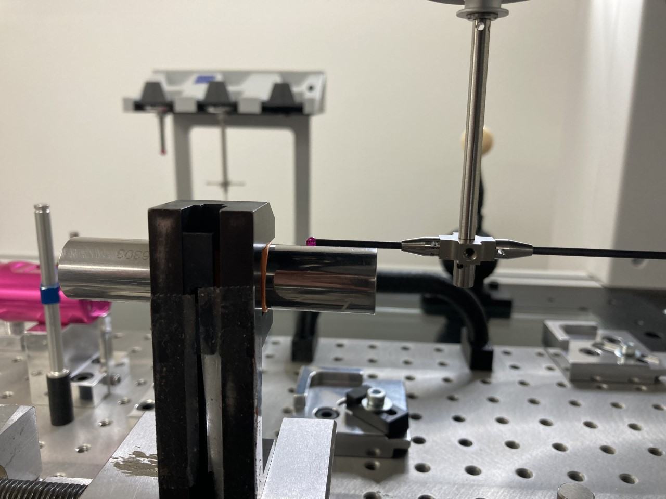
CYL 1
CYL 2

Slide 2
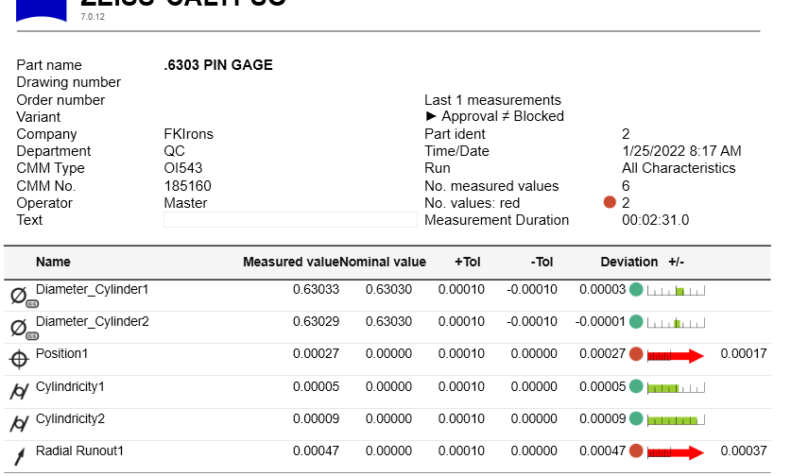
CYLINDERS DIAMETERS ARE FINE BUT THE POSITION OF CYL 2 IS OUT DESPITE 2 & 1 ARE THE SAME CYLINDER AND 1 IS THE SPATIAL ROTATION

