Slide 1
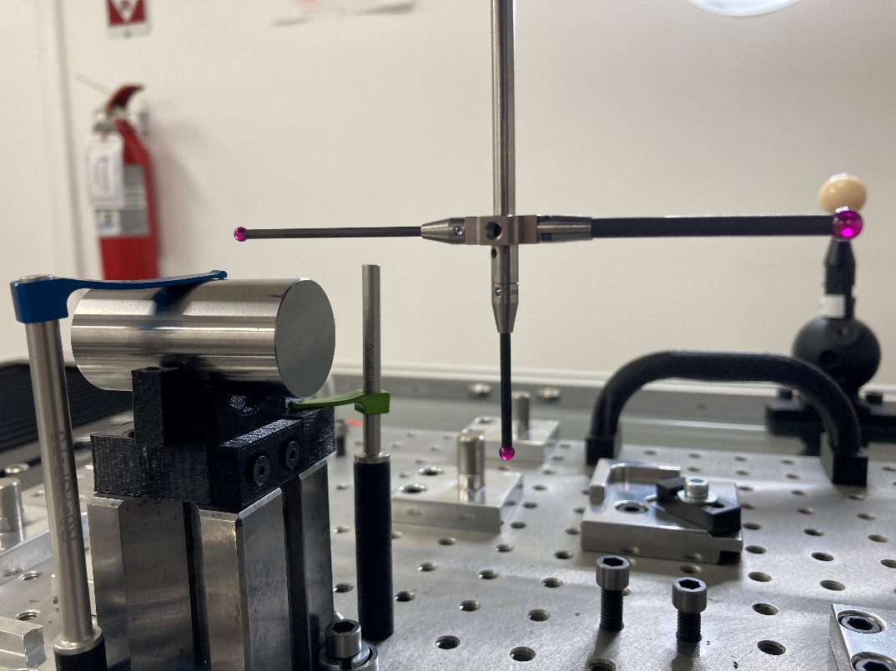
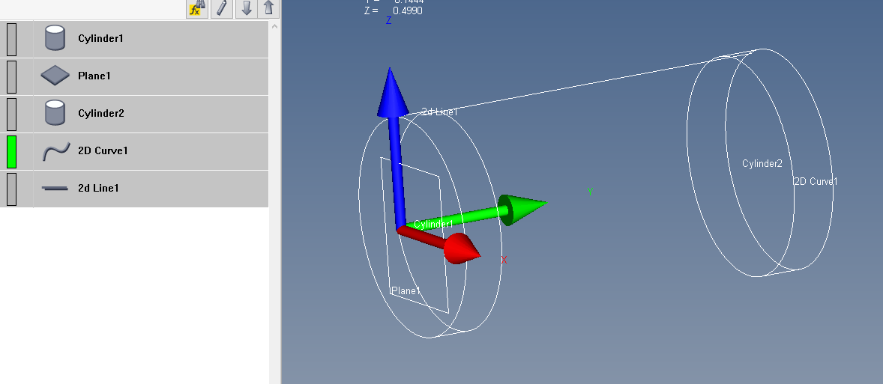
.998 PIN GAGE VERIFICAT

Slide 2
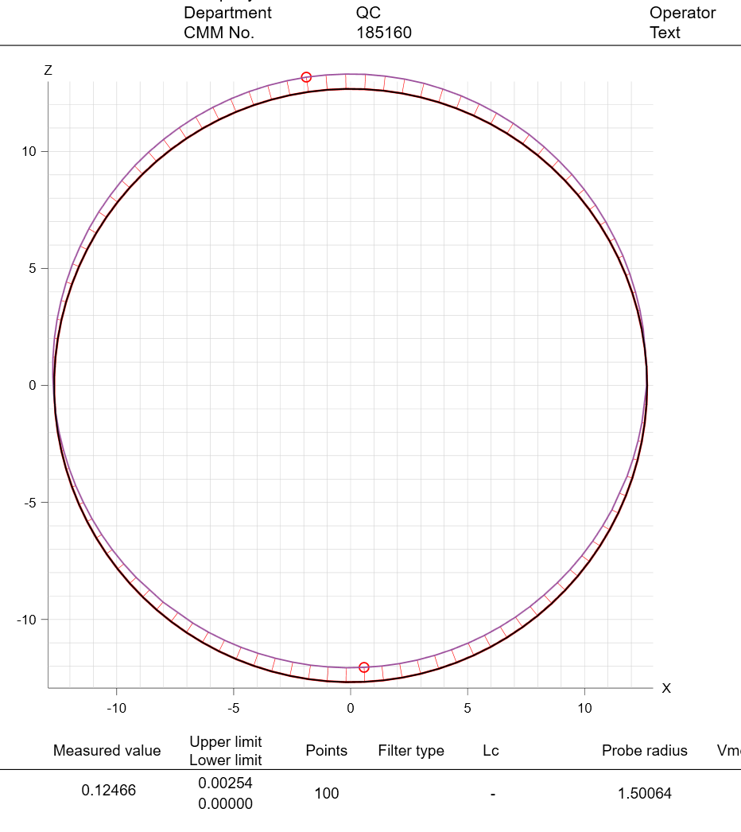
Cylinders Depth – 0.2” Cylinders Depth – 0.4”

Slide 3
