Slide 1
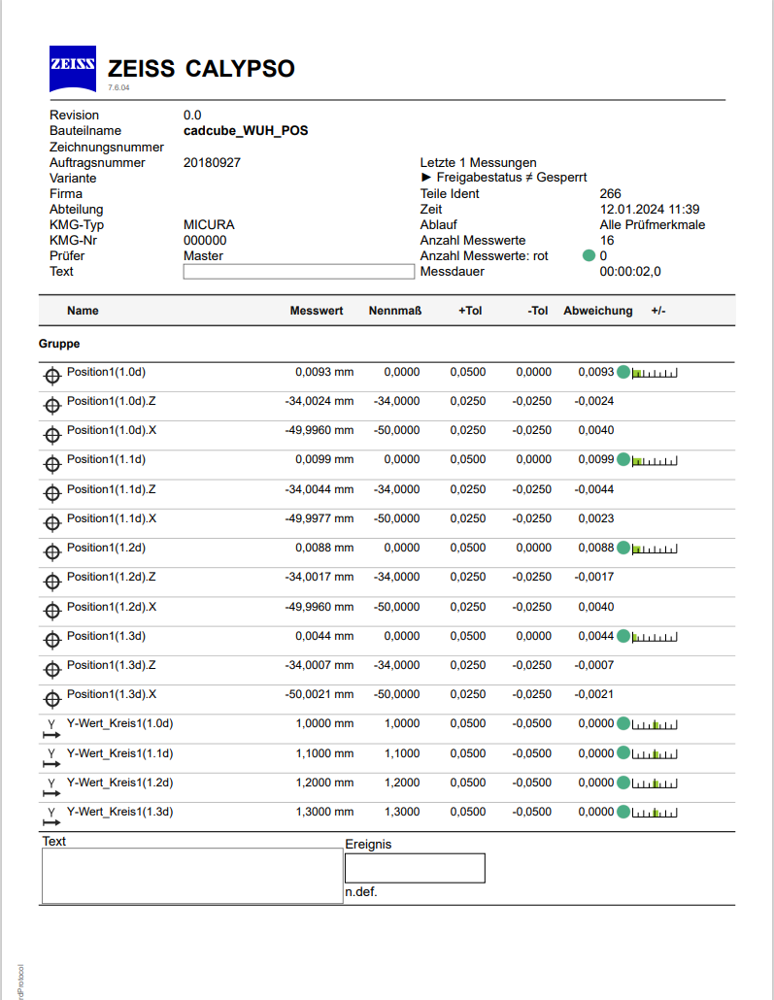
Only the characteristics circled in red should be printed in PiWeb.

